Slide 1

Sexual Assault Counselling Within the Oppressive System
Denise Eagleton
Caitlin Proctor

Slide 2
Sexual Assault Program
Two sexual assault counsellors
Established in 1994
89% of women in prison have experienced sexual assault

Slide 3
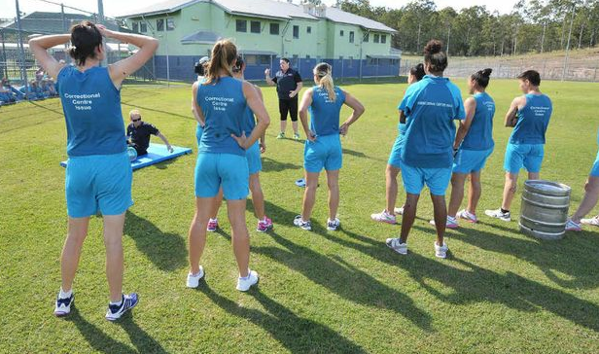
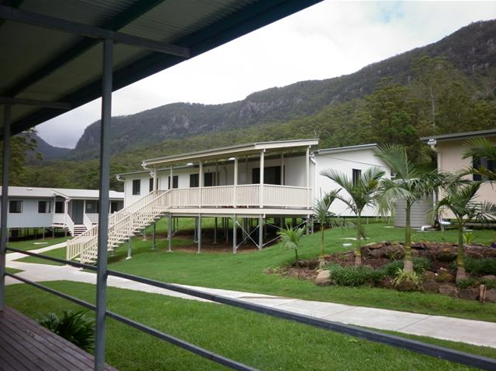
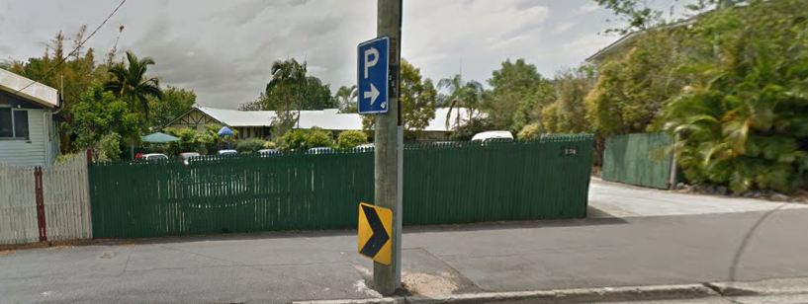
Brisbane Women’s Correctional Centre
Numinbah Women’s Correctional Centre
Helena Jones Centre
Notes:
http://cached.newslookup.com/cached.php?ref_id=112&siteid=2105&id=2060006&t=1369093680
https://qldcorrections.files.wordpress.com/2013/03/p1000449-small.jpg
https://www.google.com.au/maps/@-27.4288653,153.0428776,3a,75y,342.05h,81.71t/data=!3m4!1e1!3m2!1sKMqVfJ_EpMW2HIoYrXrILw!2e0

Slide 4
Visits to the Prisons
Monday | Tuesday | Wednesday | Thursday | Friday
 | Helena Jones | Protection | BWCC | BWCC
 |  | Numinbah
Numinbah |  | Protection | BWCC | BWCC
Week 1
Week 2

Slide 5
Types of Support
Working through experiences of abuse;
Understanding & coping with the effects of abuse;
Coping with prison; or
Just having a chat.

Slide 6
Inclusive Support Model
Woman are not clients
Support differs according to woman’s needs
Directed by the woman
Empowering

Slide 7
Challenges within the system
Appointments
Available time
Interruptions
Lockdowns

Slide 8
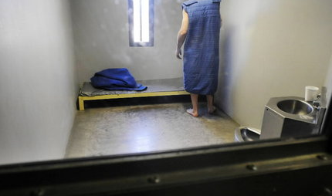
Notes:
http://blog.al.com/living-news/2010/03/alabamas_prison_suicide_rate_l.html

Slide 9

Notes:
http://www.couriermail.com.au/news/queensland/report-advises-prisons-sell-off-as-angry-union-calls-for-briefing/story-e6freoof-1226634259356

Slide 10
Complex trauma:
Undoing aloneness in the oppressive system

Slide 11
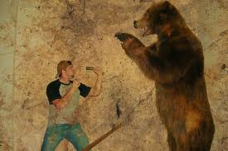
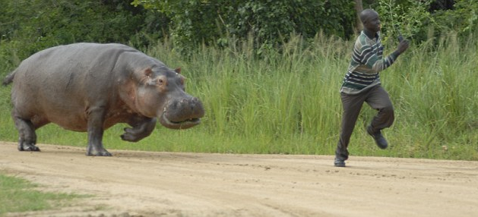
FIGHT
FLIGHT
Notes:
http://www.dailymail.co.uk/news/article-1208479/Shocked-gamekeeper-runs-life-ton-hippo.html
http://www.doctor-recommended-stress-relief.com/Fight-or-Flight-Response.html

Slide 12
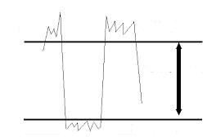
Hyper arousal (too much arousal to integrate)
Increased sensation
Emotional reactivity
Hypervigilance
Intrusive imagery
Disorganized cognitive processing
Optimum Arousal
Hypo arousal (too little arousal to integrate)
Relative absence of sensation
Numbing of emotions
Disabled cognitive processing
Reduced physical movement
Notes:
https://www.sensorimotorpsychotherapy.org/articles.html

Slide 13
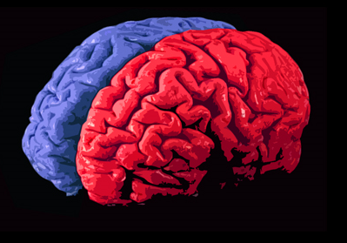
Primary Effects
“I was 5 when it started, There was no one to tell
it continued throughout my life – I just couldn’t handle it anymore
The copper said why didn't you just run –
I cant get that out of my head
why didn't I just run ”
Notes:
http://www.funderstanding.com/?attachment_id=5918

Slide 14
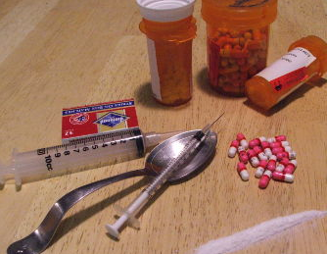
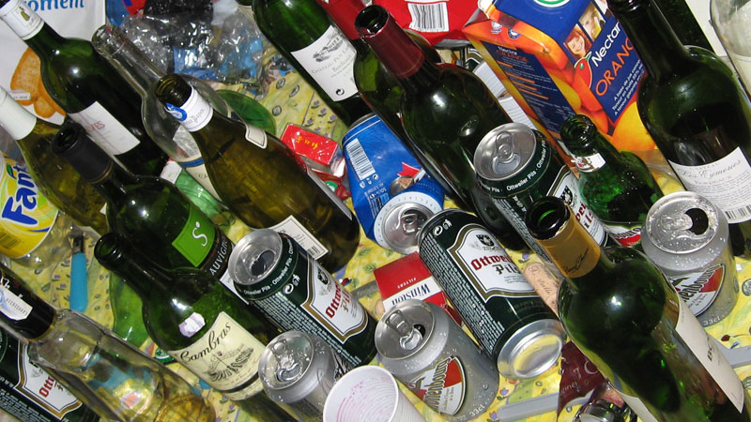
Secondary Effects
“If he yelled out my name more
than once I would be raped and beaten
I lived in fear of what would happen if I
did not help him”
Addictive behaviour arises not as a pleasure-seeking strategy but as a survival strategy
Notes:
http://uncyclopedia.wikia.com/wiki/File:Alcohol-bottles.jpg
http://monarchlegal.com/drug-possession

Slide 15
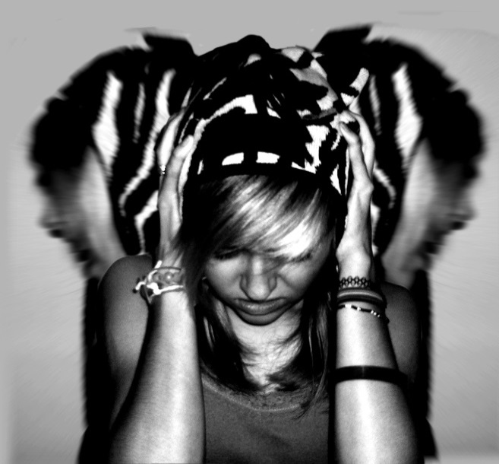


Tertiary Effects
Bipolar Disorder
Antisocial
Depression
Notes:
http://www.elephantjournal.com/2011/05/are-you-hiding-depression-behind-your-yoga-catherine-ghosh/
http://preapism.com/wp-content/uploads/schizophrenia_from_drugs.jpg
http://goingrawvegan.net/2014/02/25/mania/

Slide 16
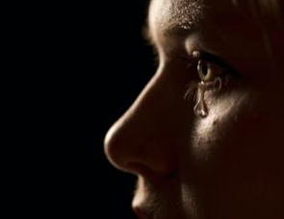

Slide 17
“The human heart yearns for contact; above all it yearns for genuine dialogue. Each of us secretly and desperately yearns to be met, to be recognised in our uniqueness, our fullness, and our vulnerability” (Hycner & Jacobs, 1995, p.9).

Slide 18
References for Images
http://cached.newslookup.com/cached.php?ref_id=112&siteid=2105&id=2060006&t=1369093680
https://qldcorrections.files.wordpress.com/2013/03/p1000449-small.jpg
https://www.google.com.au/maps/@-27.4288653,153.0428776,3a,75y,342.05h,81.71t/data=!3m4!1e1!3m2!1sKMqVfJ_EpMW2HIoYrXrILw!2e0
http://blog.al.com/living-news/2010/03/alabamas_prison_suicide_rate_l.html
http://www.couriermail.com.au/news/queensland/report-advises-prisons-sell-off-as-angry-union-calls-for-briefing/story-e6freoof-1226634259356
http://www.dailymail.co.uk/news/article-1208479/Shocked-gamekeeper-runs-life-ton-hippo.html
http://www.doctor-recommended-stress-relief.com/Fight-or-Flight-Response.html
https://www.sensorimotorpsychotherapy.org/articles.html
http://www.funderstanding.com/?attachment_id=5918
http://uncyclopedia.wikia.com/wiki/File:Alcohol-bottles.jpg
http://monarchlegal.com/drug-possession
http://www.elephantjournal.com/2011/05/are-you-hiding-depression-behind-your-yoga-catherine-ghosh/
http://preapism.com/wp-content/uploads/schizophrenia_from_drugs.jpg
http://goingrawvegan.net/2014/02/25/mania/

