Slide 1
Gender’s Role in Abolitionist Pedagogy: A fictionalized autoethnography through letters from prison
Shelby A. Ferreira
University of Rhode Island/Rhode Island College
United States

Slide 2
Problem
Prison-based education, the antidote to the US’s epidemic of mass incarceration, faces many challenges. Gender plays a role in those challenges, yet its role is not well researched. Thus, an exploration of gender’s role in abolitionist pedagogy is in order.

Slide 3
Significance
US epidemic of mass incarceration
Within prisons exist experts with potential cure this epidemic
Prisons “integral to understanding the larger constellation” of societal ills (Vaught, 2012)
Recursive effect on greater society
Instead of dumping grounds
Vehicles for transformation

Slide 4
Autobiographical Information
Commitment to most vulnerable populations
Prison abolitionist
Ex-prison educator
University Affirmative Action administrator
Educational researcher

Slide 5
Terms of Interest
Abolitionist pedagogy
Autoethnography
Gender
Humanistic

Slide 6
Background
US has world’s highest incarceration rates (Alexander, 2010; Glaze & Herberman, 2013)
Astronomical re-incarceration rates (Esperian, 2010)
Decreases associated with prison-based education (Davis, Bozick, Steele, Saunders, & Miles, 2013; Esperian, 2010)
Cultural transmission model dominates (Burton-Rose & Wright, 1998; Kohlberg & Mayer, 1972; Williford, 1994)

Slide 7
Background
Further decrease associated with prison-based humanistic education (PBHE) (Davis, et al., 2013; Esperian, 2010; Frank, Omstead, & Pigg, 2012; Nally, Lockwood, Knutson & Ho, 2012; Palmer, 2012; Rafay, 2012; Steurer, Linton, Nally & Lockwood, 2010; US. Department of Education, 2012; Vaught, 2012; Ward, 2009; Warner, 2007)
PBHE suggests abolitionist potential (Larson, 2011; Scott 1998)
Institutional challenges to abolitionist pedagogy (Ferreira, 2013; Kilgore, 2011)
Role of gender in challenges to abolitionist pedagogy(Ferreira, 2013)

Slide 8
My Experience
Gender-relevant, context-specific, critical, democratic pedagogy within a women’s medium-security prison
Sexual abuse
Patriarchy
Psychiatric drugs
Context-specific, critical, democratic pedagogy within a men’s maximum-security prison
Hyper-masculinity
Conformity to inherited penal system
Termination
Hyper-sexualization
All the Way Home
Criminalization

Slide 9
Purpose
In-depth exploration of gender’s role in the perception, implementation, and effects of abolitionist pedagogy
Amplify the voices of incarcerated experts

Slide 10
Theoretical Framework
Social reconstruction ideology(Schiro, 2012)
Society unhealthy
Education as means to envision a new one
Prison abolition ideology (Davis, 2003)
Just & equitable society doesn’t need prison
Restorative justice
Critical feminist theory (Butler, 1990; Rhode, 1989)
Gender inequity
Gender roles
Sexualization
Hetero-normativity

Slide 11
Review of the Literature
Prison-based education (Burton-Rose & Wright, 1998; Davis, Bozick, Steele, Saunders, & Miles, 2013 ; Esperian, 2010; Jones & d’Errico, 1994; Kilgore, 2011; Kohlberg & Mayer, 1972; Williford, 1994)
Prison-based humanistic education [PBHE] (Bordt & Carceral, 2012; Davis, et al., 2013; Esperian, 2010; Frank, Omstead, & Pigg, 2012; Halperin, Kessler, & Braunschweiger, 2012; Hartnett, 2011; Kilgore, 2011; Larson, 2011; Lee, 2010; Lockard & Rankins-Robertson, 2011; Nally, Lockwood, Knutson & Ho, 2012; McCarty, 2006; Olinger, et.al, 2012; Palmer, 2012; Rafay, 2012; Shieh, 2010; Steurer, Linton, Nally & Lockwood, 2010; US. Department of Education, 2012; Ward, 2009; Warner, 2007 Williford, 1994)
Abolitionist pedagogy (Hartnett, 2011; Kilgore, 2011; Larson, 2011; Palmer, 2012; Wright, 2004)
Gender & institutions (Brown, 2005; Connell, 1996; Davis, 2003; Lempert, Bergeron, & Linker, 2005; Martin, 1994; Rowe, 2004)

Slide 12
Research Question
Gap in literature: Role of gender in abolitionist pedagogy
What role does gender play in the perception, implementation, and effects of abolitionist pedagogy?

Slide 13
Methodology
Pragmatic (Biesta & Burbules, 2003)
Find means to achieve educational ends
My expertise)
Qualitative (Maxwell, 2005; Patton, 2002)
Exploratory
Autoethnographic (Chang, 2008)
Culture
Personal expertise

Slide 14
Data Sources
Observational/Self-Reflective (Chang, 2008)
Field journal
Personal journal
Personal art/creative projects
Analytic memos
External
Texts generated from incarcerated students
Interviews & field notes from All the Way Home
Letters/art/other incidental documents from incarcerated loved ones/acquaintances

Slide 15
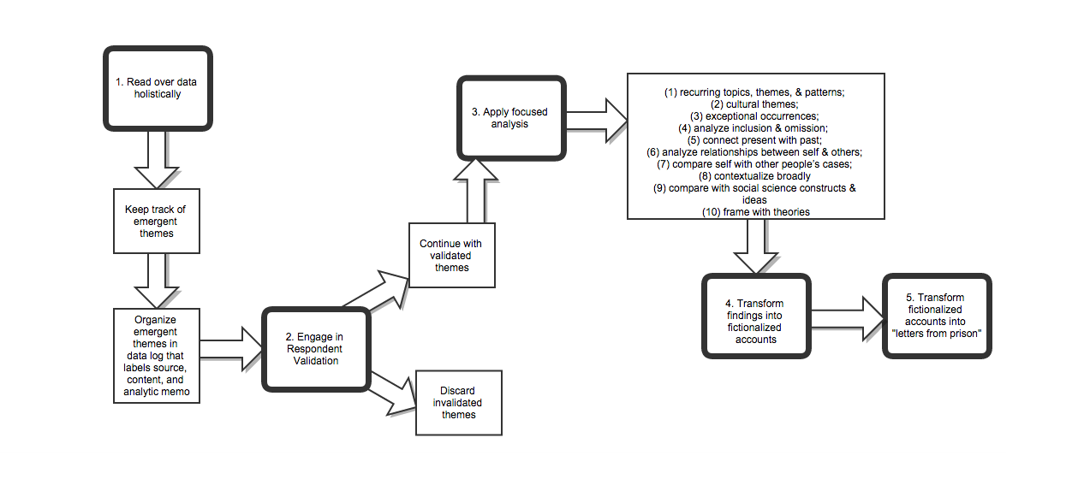
Data Analysis and Transformation Procedure
(Chang, 2008)

Slide 20
Ethical Considerations
Confidentiality
Responsibility to students/participants

Slide 21
Presentation of Findings
Fictionalized accounts (Greene, 1988; Sconiers, 2000)
De-identifying data, confidentiality
Question values
“Letters from prison”
Counternarrative (Bamburg & Andrews, 2004; Baszile, 2005)
Form (Barone, 2001; Greene, 1998)

Slide 22
Preliminary Findings/Implications
Findings:
Gendered culture/institution as barrier to abolitionist pedagogy
Incarcerated people have solutions
Implications:
Communities of practice, incarcerated people, prison personnel, educators

Slide 23
Suggestions for Future Research
Roles of race/ethnicity, economics, etc. in abolitionist pedagogy?
How might we use our knowledge of the role of gender in prison-based education in order to better align with an abolitionist vision?

Slide 24
References
(Available upon request)

Slide 25
Thank you!
Questions/feedback?

