Slide 1
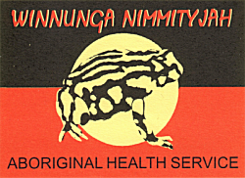
Delivering the Winnunga Holistic Health Care Prison Model A
Nerelle Poroch

Slide 2
Aboriginal Health is: Holistic, encompassing mental health and physical, cultural and spiritual health …. Swan, P. & Raphael. B. 1995. ‘Ways Forward’ National Consultancy Report on Aboriginal and Torres Strait Islander Mental Health, Part 1. Australian Government Publishing Service. Canberra

Slide 3
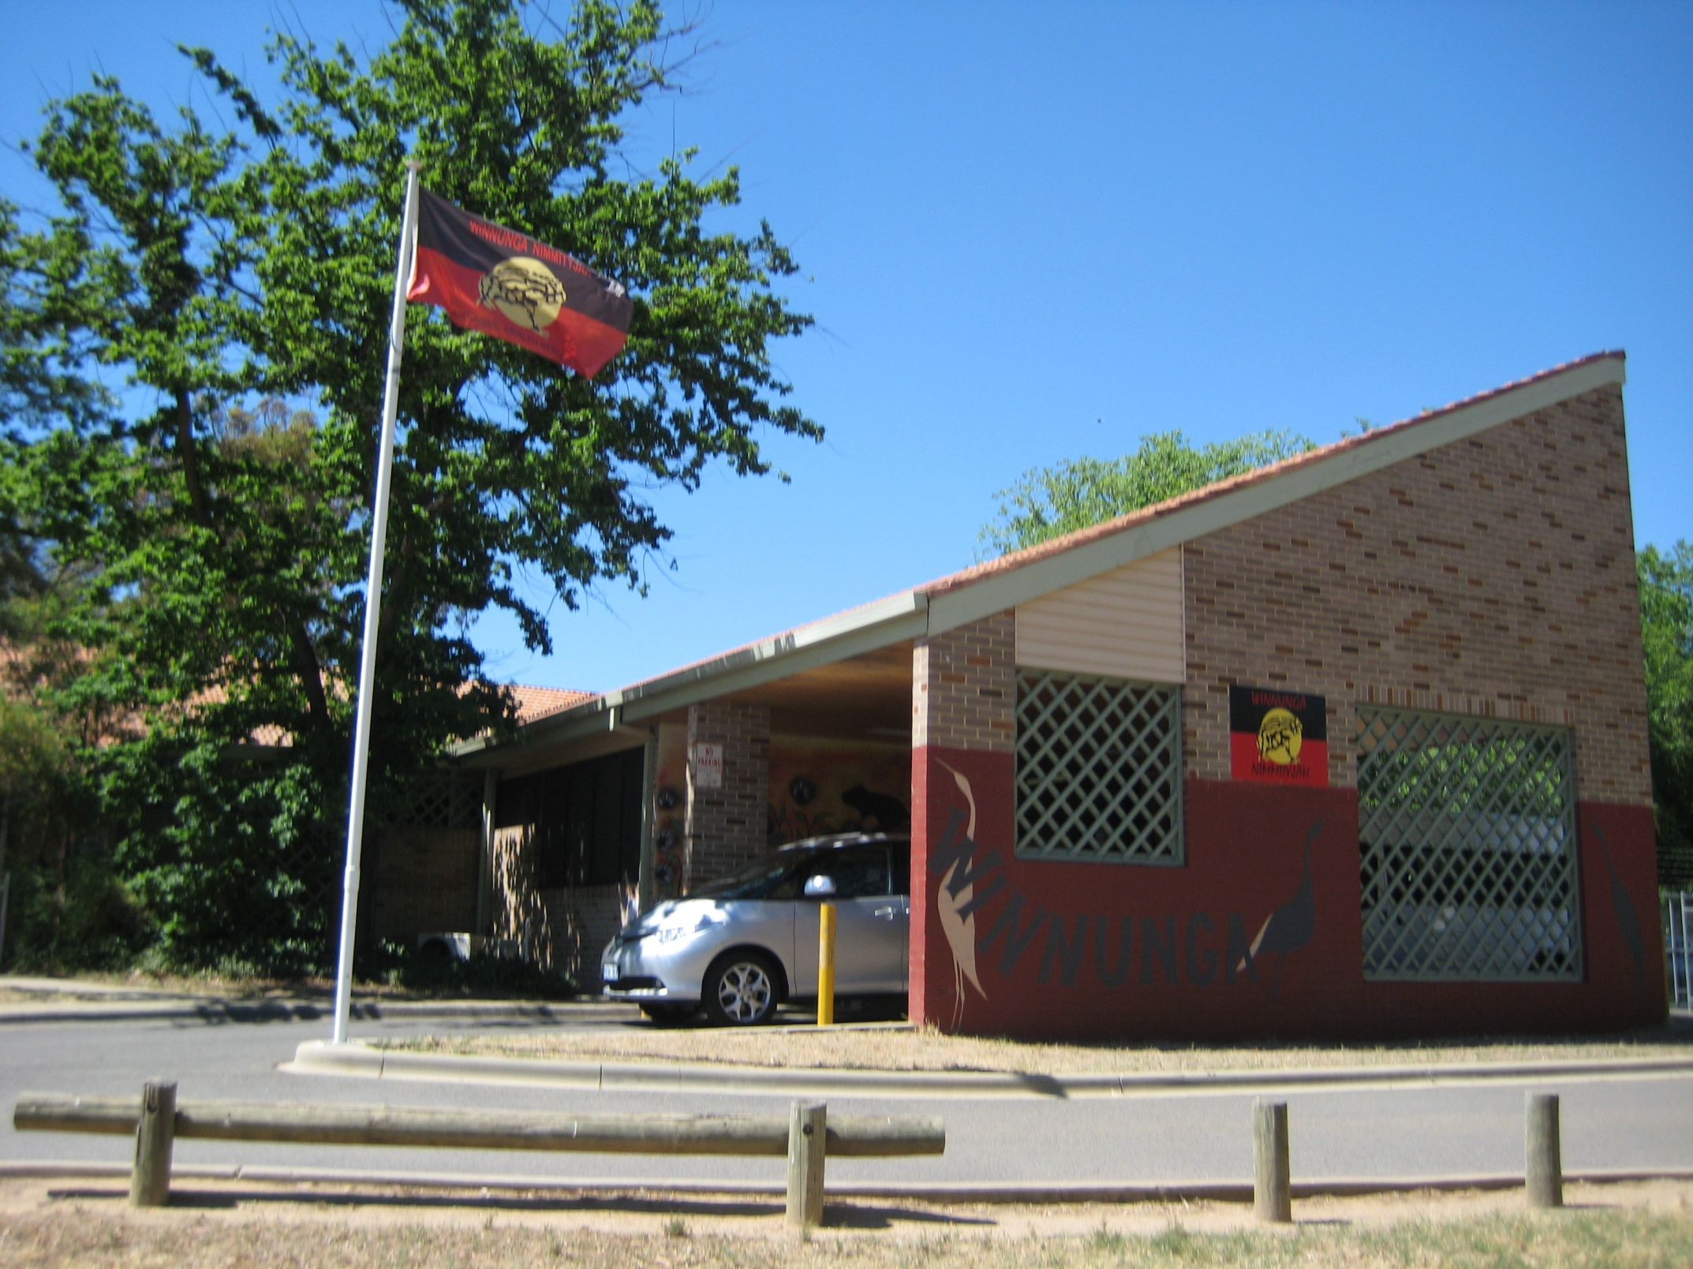
WINNUNGA’S CURRENT LOCATION IN NARRABUNDAH, ACT

Slide 4
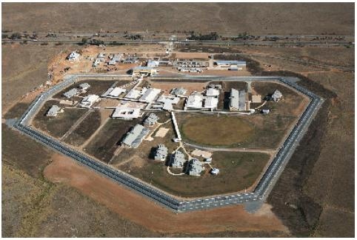
ALEXANDER MACONOCHIE CENTRE, ACT
The Model has three parts:
Incarceration
Release from prison
Breaking the cycle of incarceration

Slide 5
ALEXANDER MACONOCHIE CENTRE, ACT

Slide 6
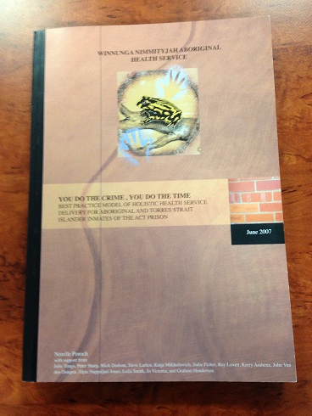

Slide 7
WE’RE STRUGGLING IN HERE REPORT

Slide 8
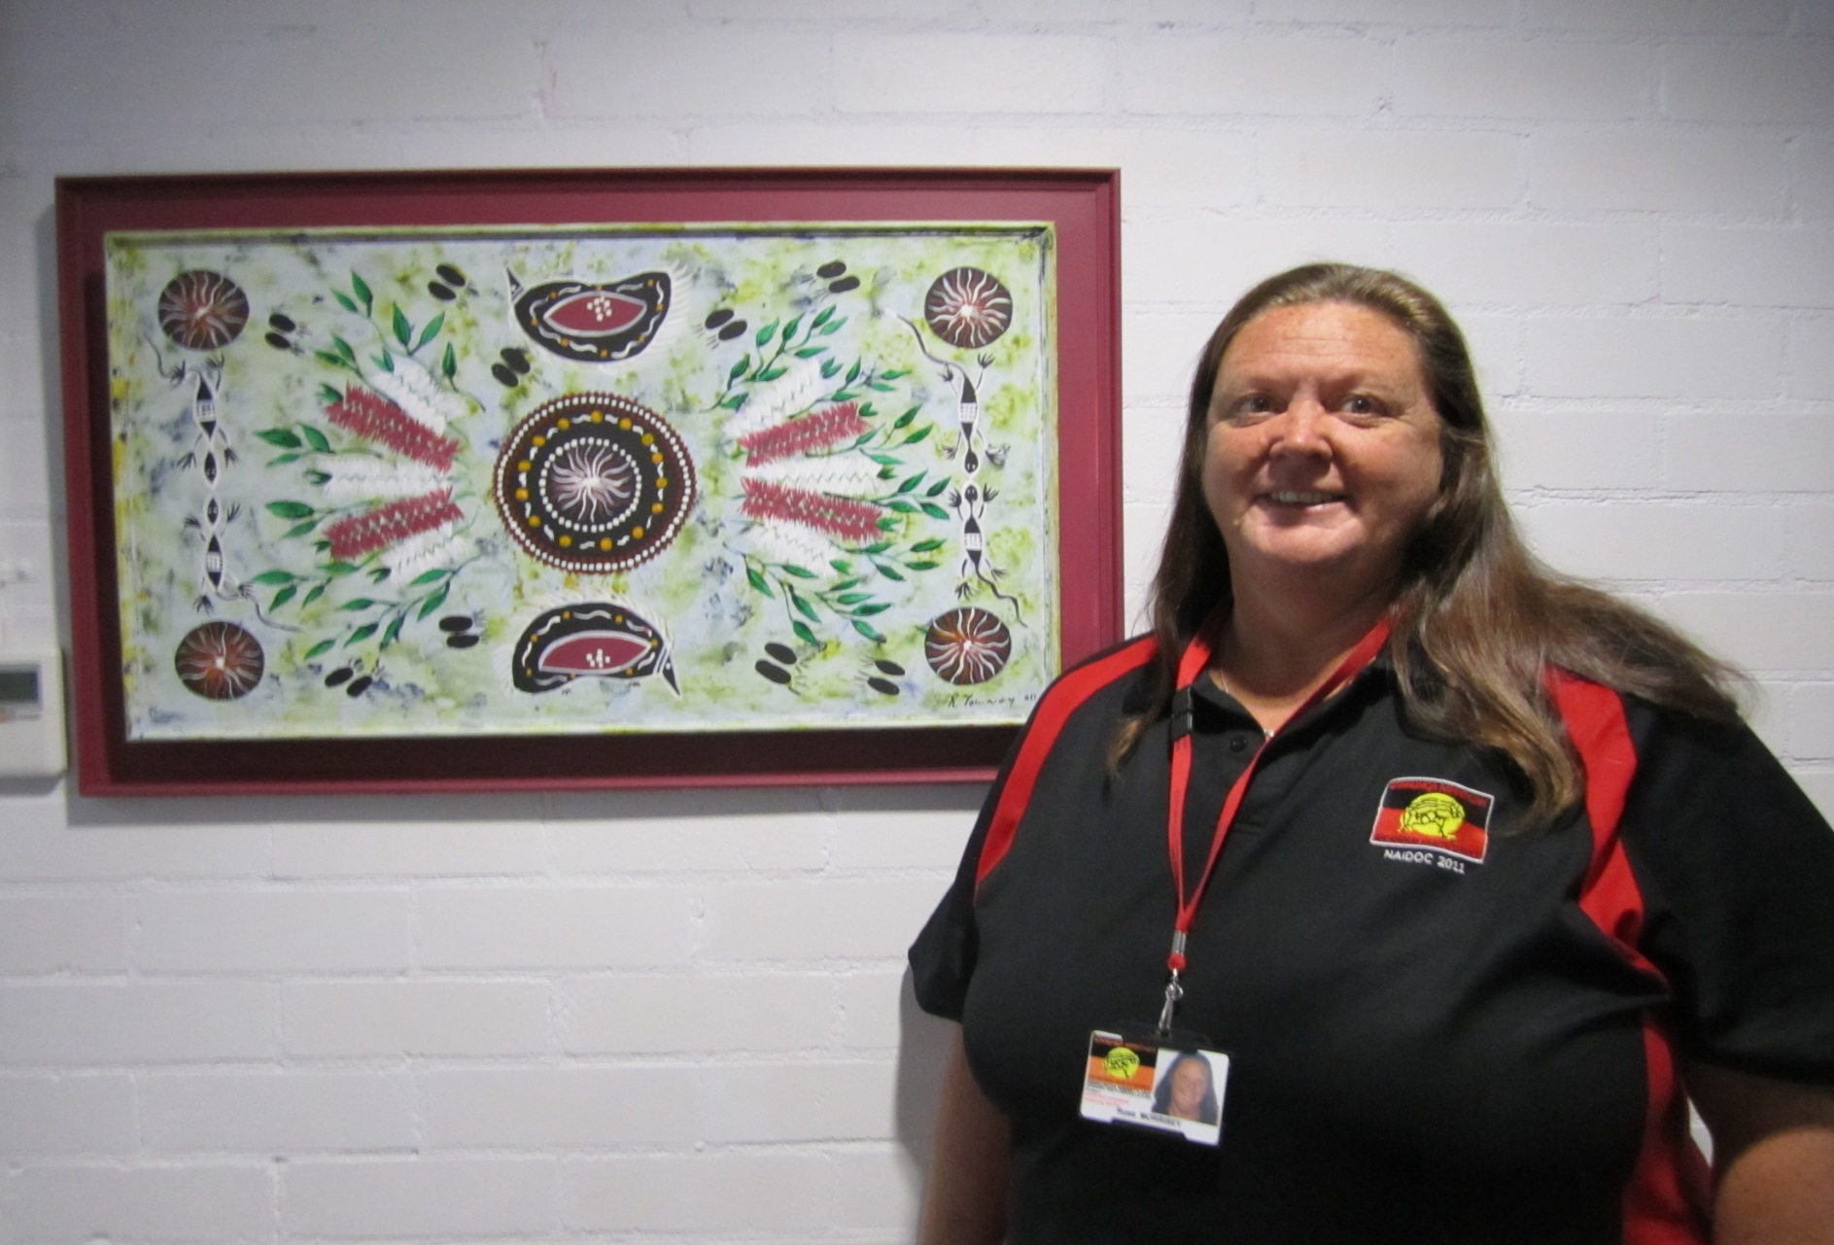
WINNUNGA AMC ABORIGINAL HEALTH WORKER

Slide 9
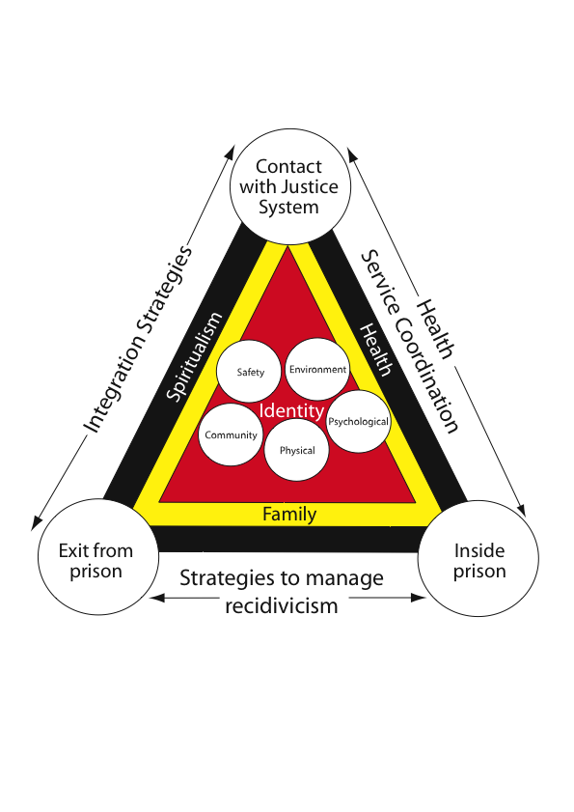
WINNUNGA HOLISTIC HEALTH CARE PRISON MODEL

Slide 10
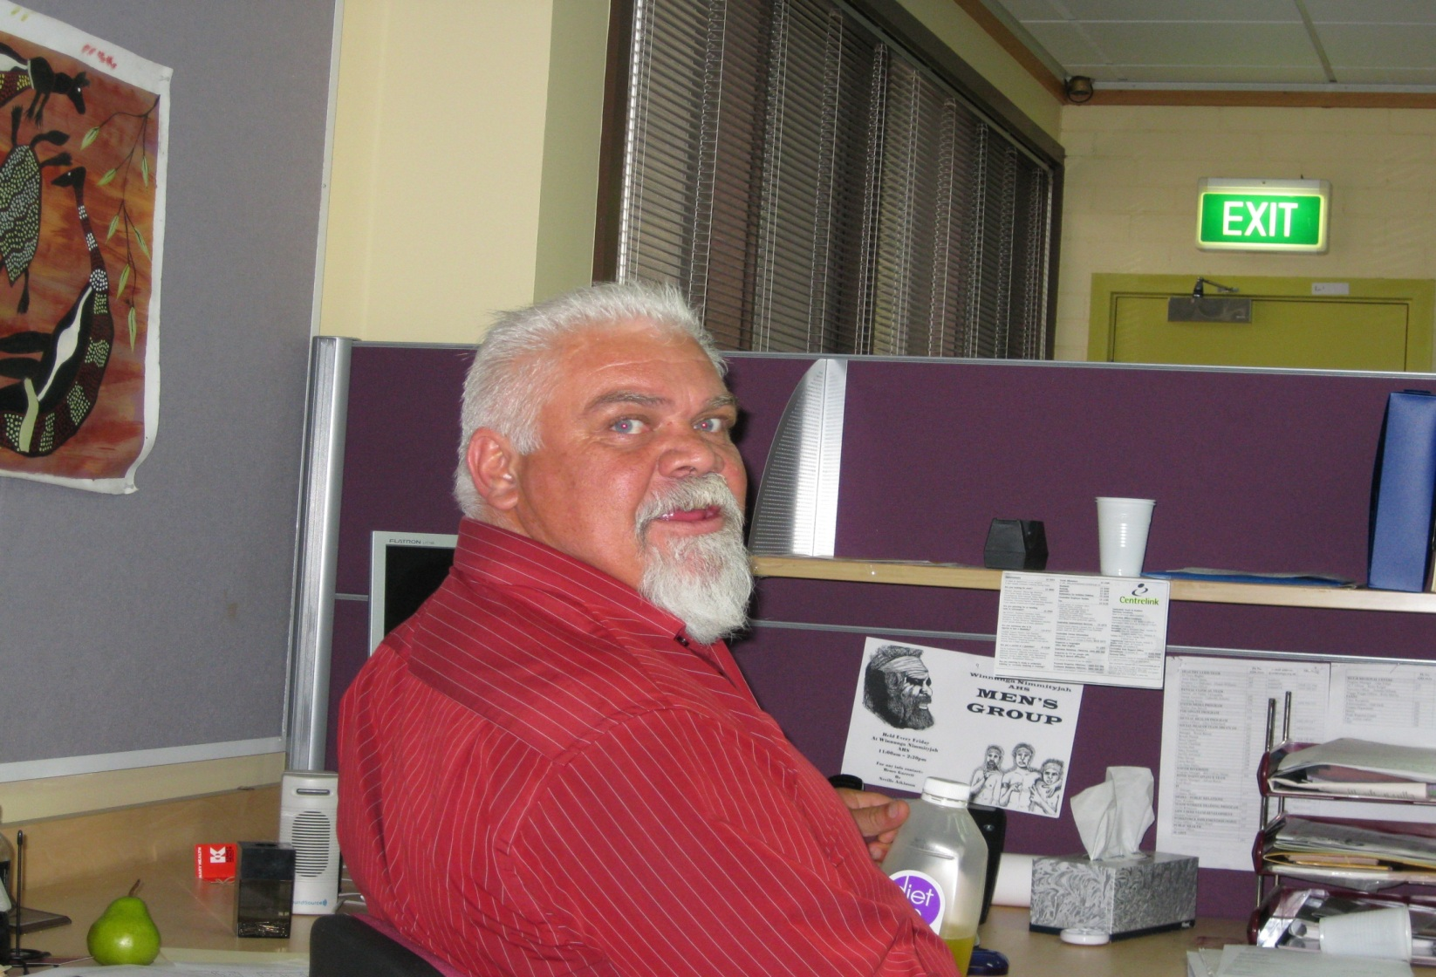
WINNUNGA AMC ABORIGINAL HEALTH WORKER

Slide 11
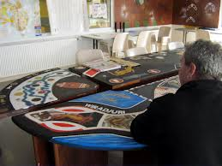
WINNUNGA ART CLASSES AT THE AMC

Slide 12
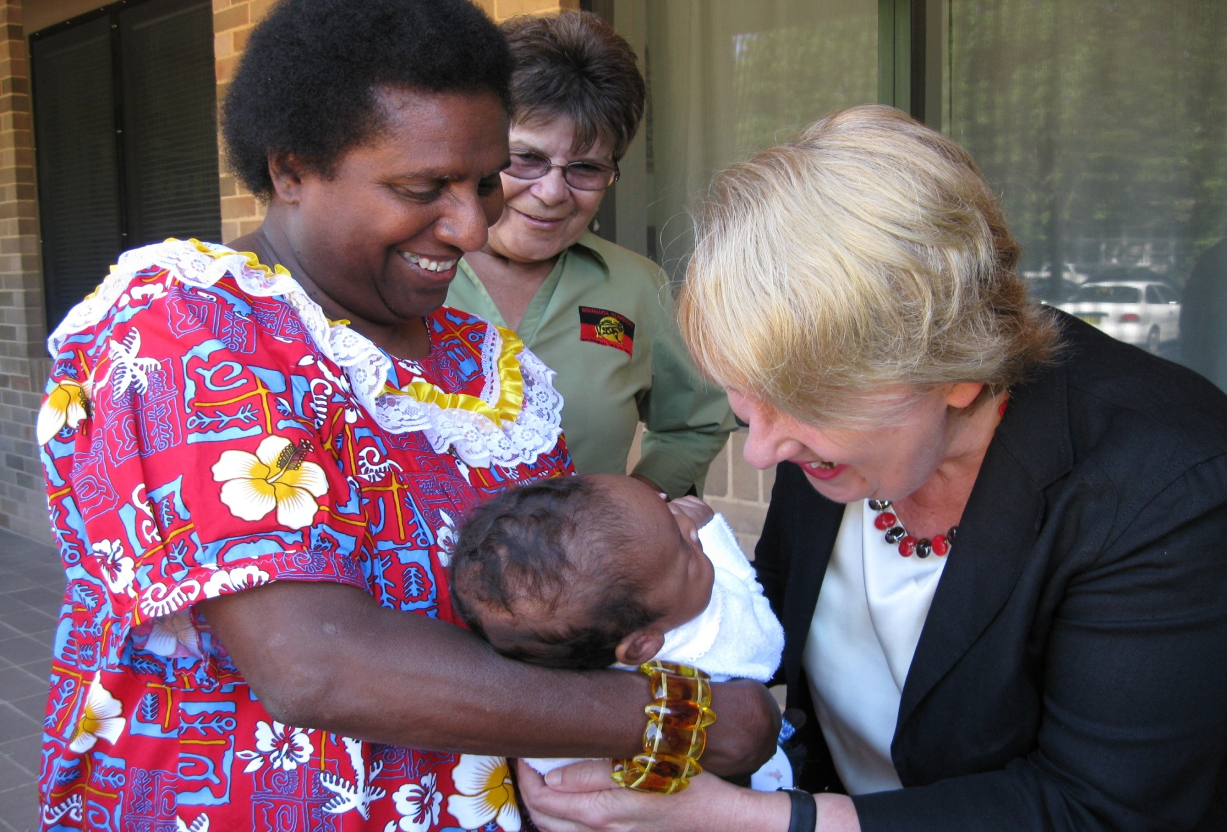
WINNUNGA MIDWIFERY PROGRAM

Slide 13
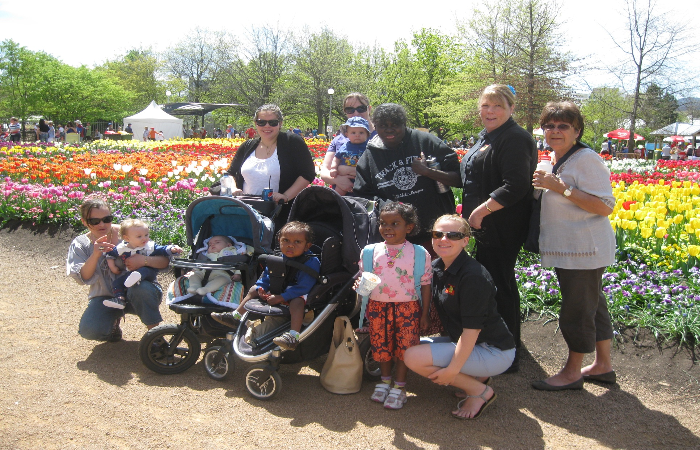
WINNUNGA MUMS’ AND BUBS’ GROUP AT FLORIADE

Slide 14
I need help from everywhere. It is a big what if. The Aboriginal Liaison Officer said she would keep in contact because I need support and I did not have it before. Now I know what I want and I have to ask for help. It has been hard to open up to people but I am doing this.
(Aboriginal female respondent)

Slide 15
They are not going to bullshit with you;
They will tell you honestly;
And they make you feel they will be there to help you. (Aboriginal male respondent)

Slide 16
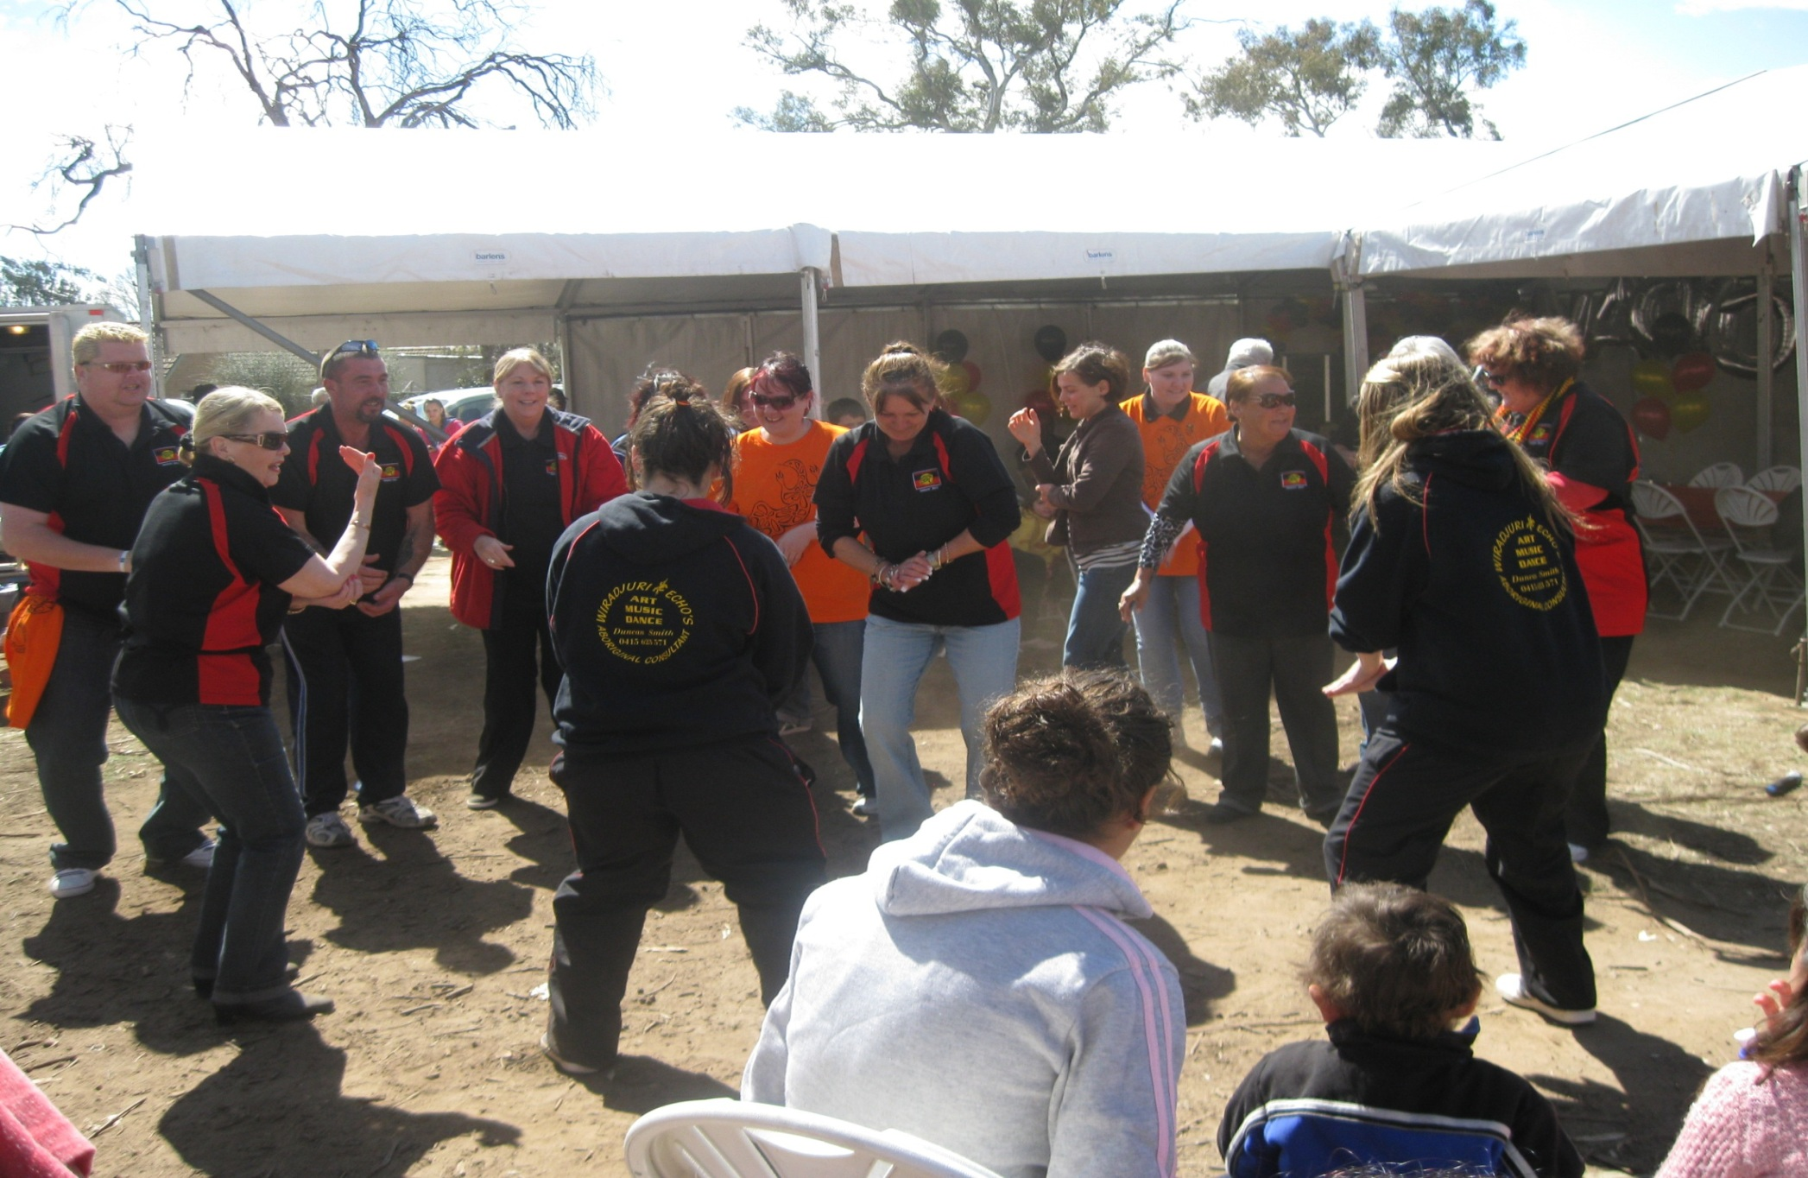
NAIDOC DAY AT WINNUNGA

