Slide 3
Notes:
PeerZone works on three levels for participants: It invites them to rebuild a more positive story of their lives. It offers tools for whole of life wellbeing. It creates a community of mutual support.
PeerZone works on three levels for services: It’s a service innovation for organisations that invest in it. It’s a practice tool and support structure for workers with lived experience who facilitate it. It’s a personal development opportunity for service users who participate in it.

Slide 4
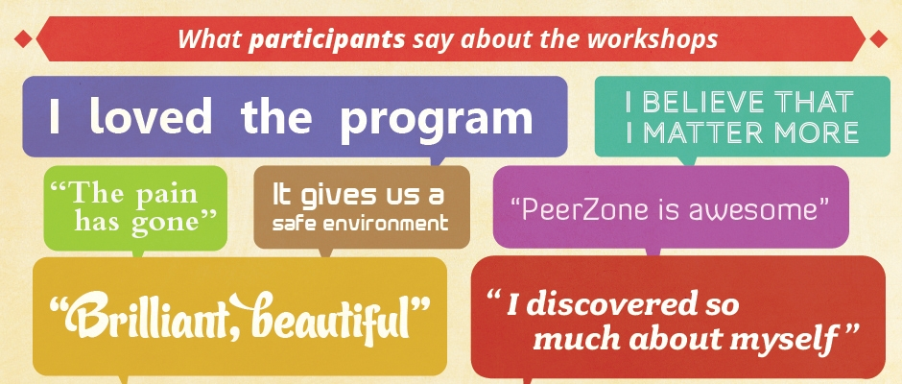

Slide 6
Notes:
PeerZone is a series of three hour peer led workshops in mental health and addiction where people explore recovery and whole of life wellbeing. PEER SUPPORT PAPERS. PEER SUPPORT NETWORKS AND ORGANISATIONS. ADDICTION PEER SUPPORT. SELECTED PEERZONE WORKSHOP RESOURCES. GENERAL PEER RESOURCES
.

Slide 7
Notes:
Foundation series. Understanding our distress. Understanding our alcohol & drug use. Leading our recovery. Exploring our stories

Slide 8
Notes:
Dealing to self-stigma. Finding our voices. Empowering ourselves in mental health services. Empowering ourselves in alcohol & other drugs services. Dealing with crisis

Slide 9
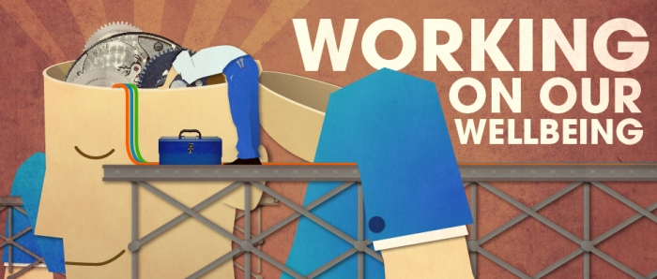
Notes:
Coping with stress. Understanding trauma. Minding our lifestyle.

Slide 10
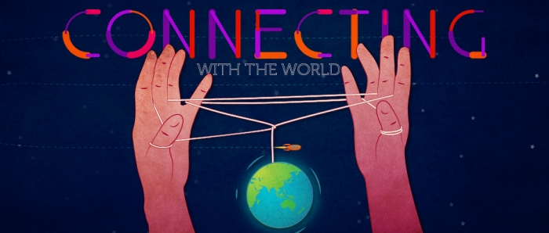
Notes:
Enhancing our relationships. Maximising our income. Finding and keeping a home. Finding and keeping work

Slide 11
Notes:
Toku Oranga. Wellbeing for young people. Wellbeing for men.

Slide 12
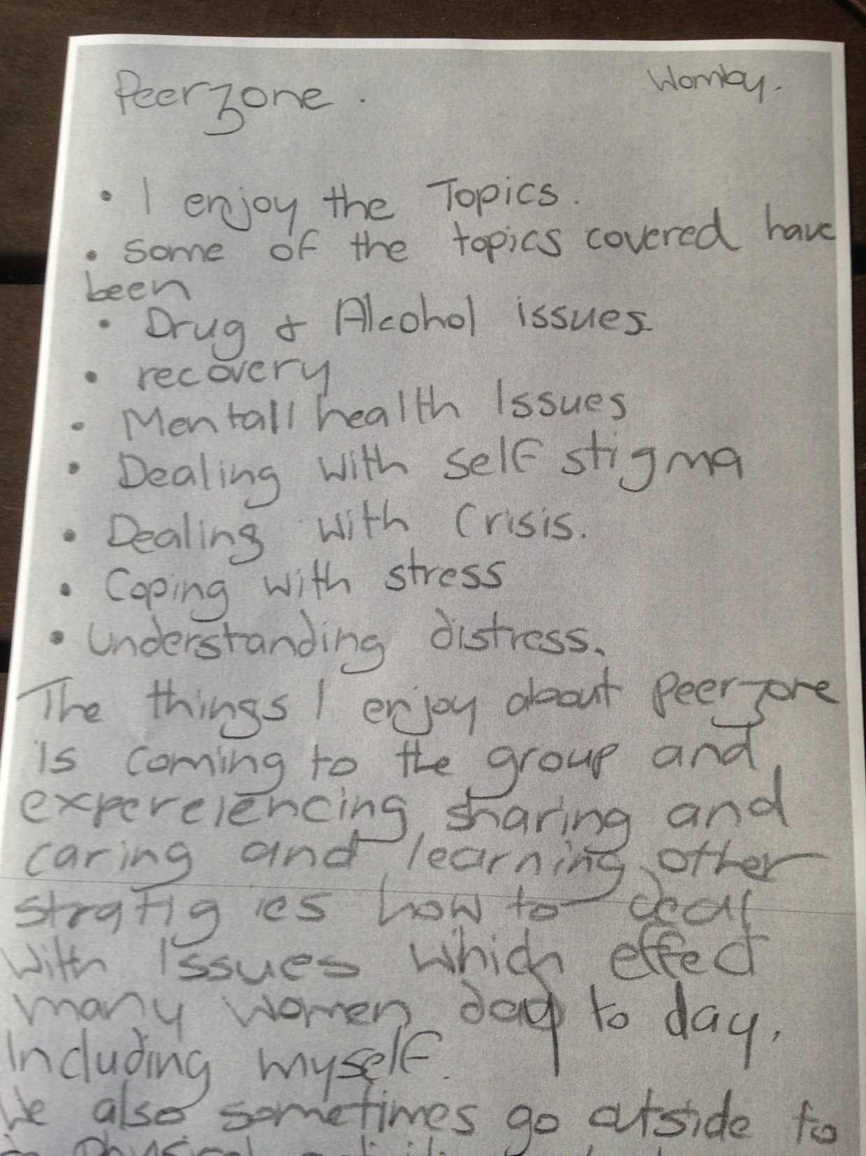

Slide 13
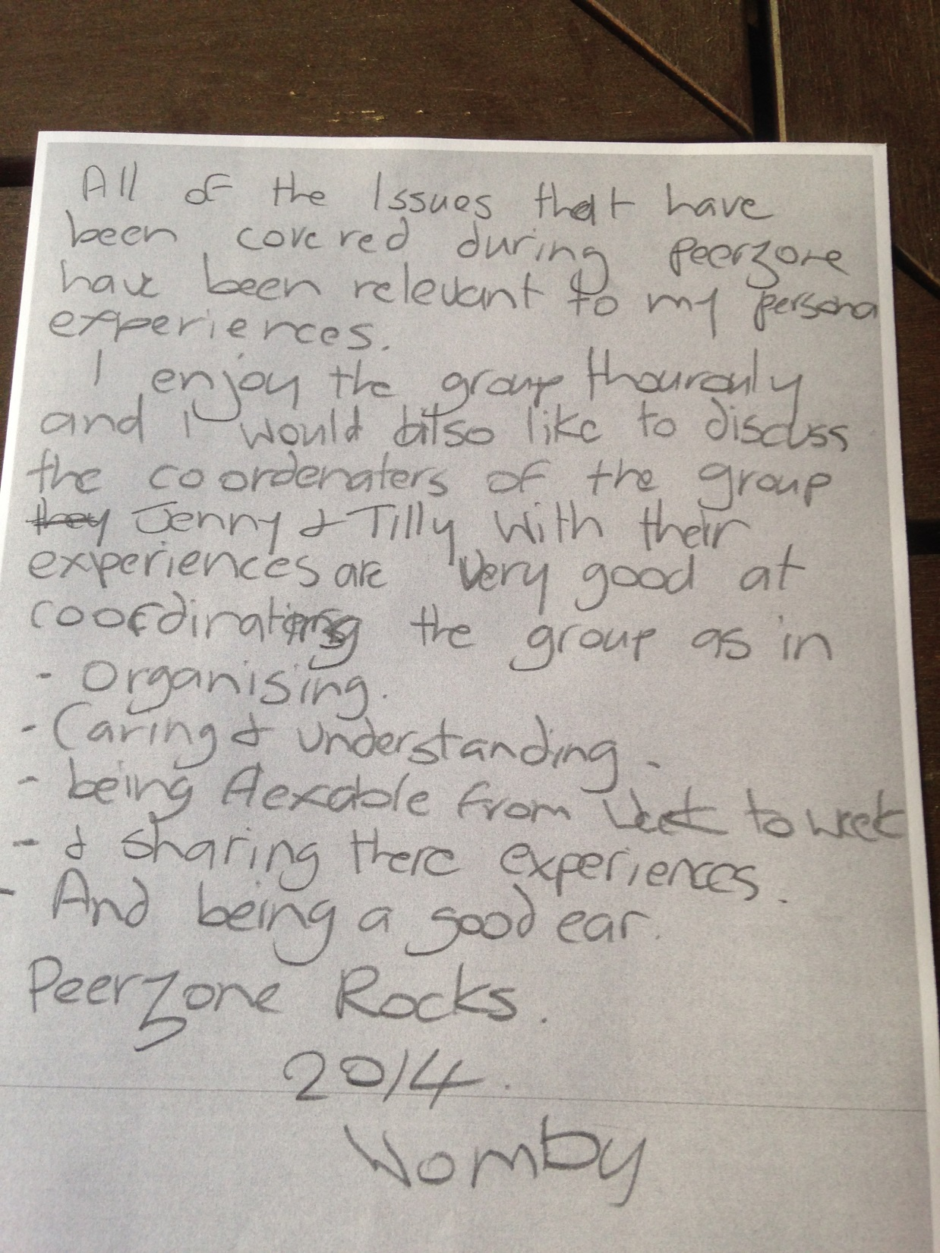

Slide 14
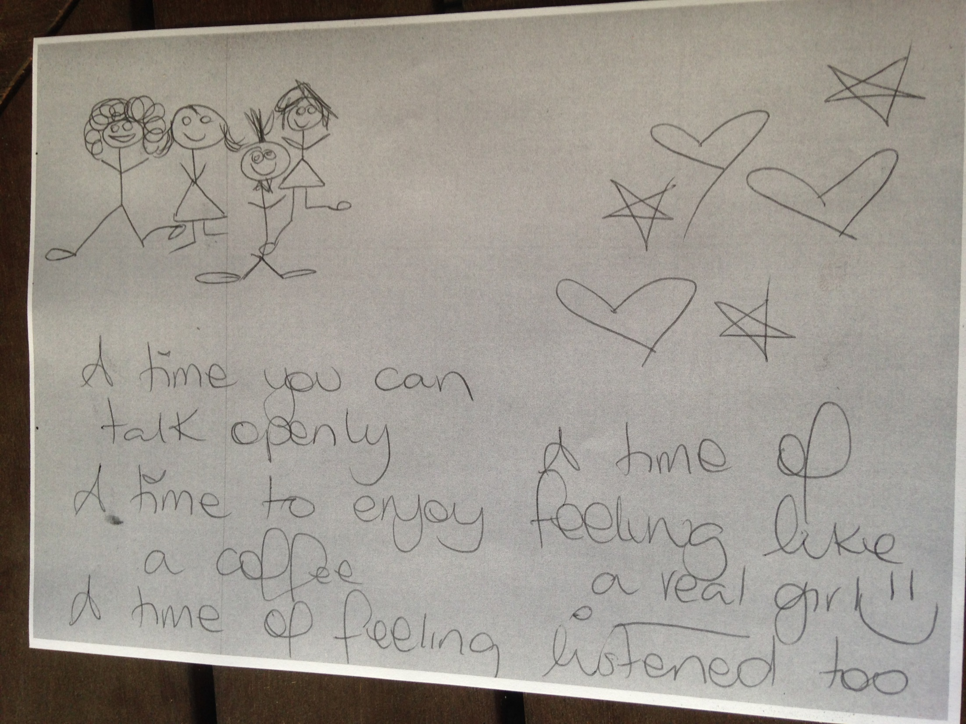

Slide 15
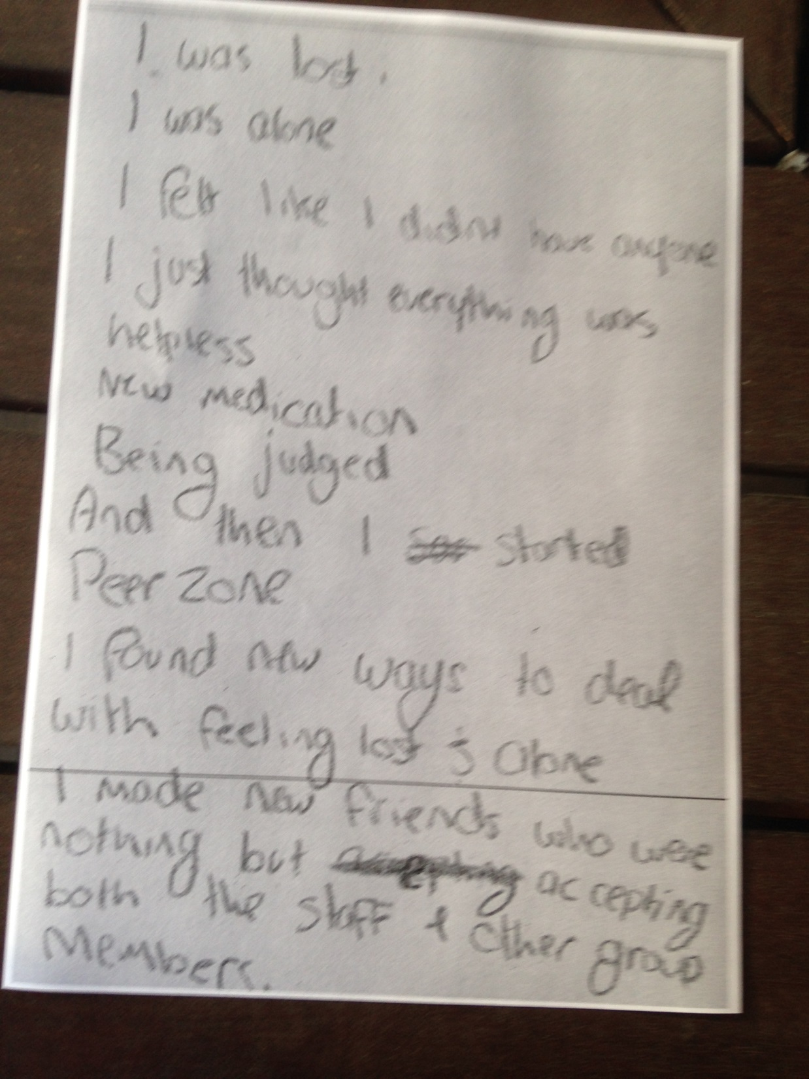

Slide 16
