Slide 1
#STAW

Slide 2

#STAW

Slide 3
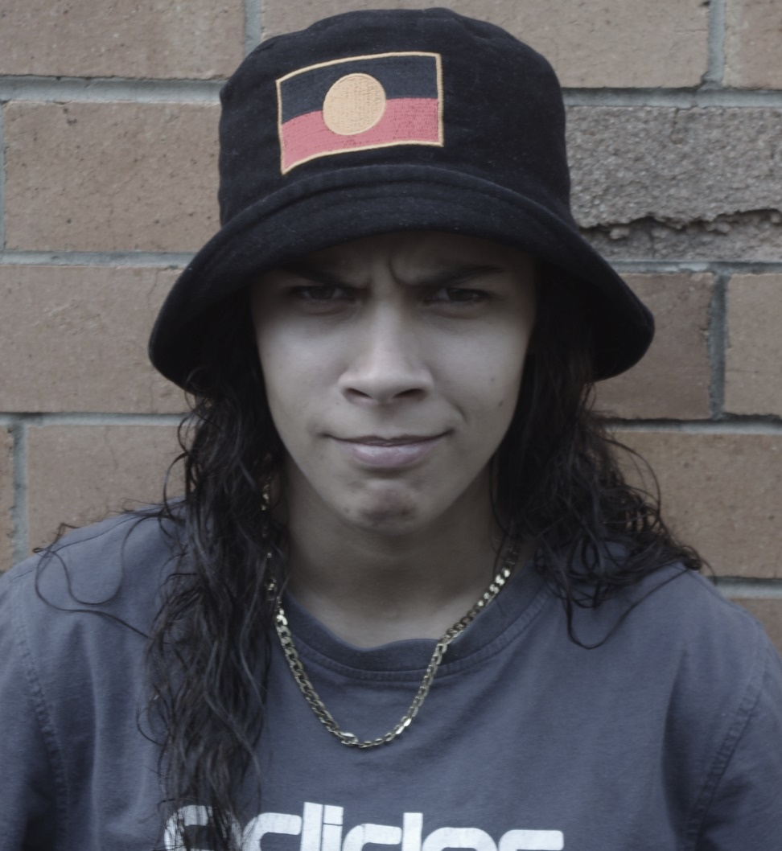
Homeless?

Slide 4
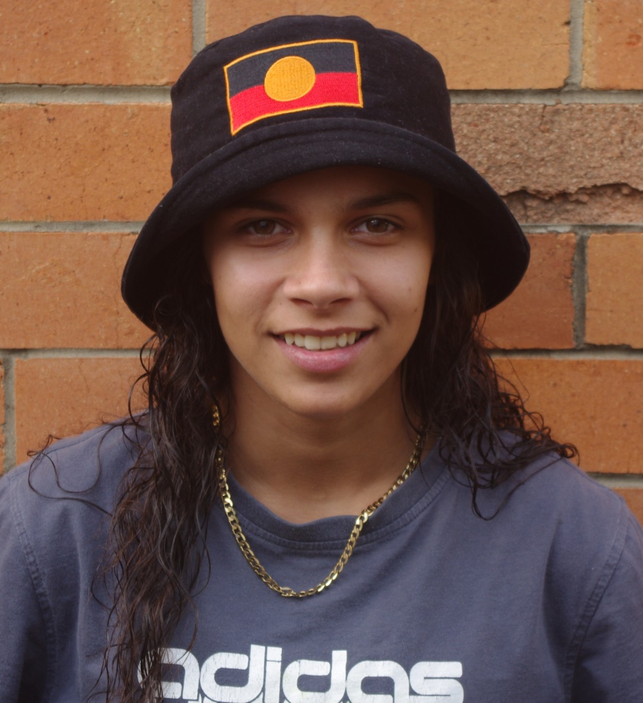
Homeless?
Employed?

Slide 5
Employed?

Slide 6
We choose how we see people
#STAW

Slide 7
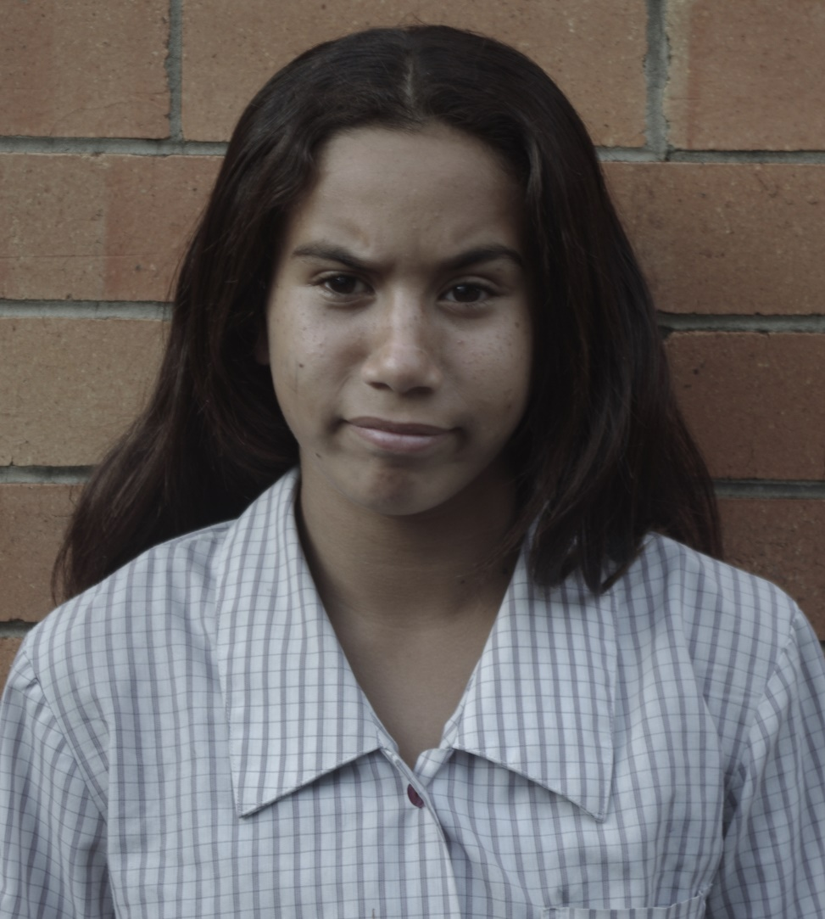
Disrespectful?

Slide 8
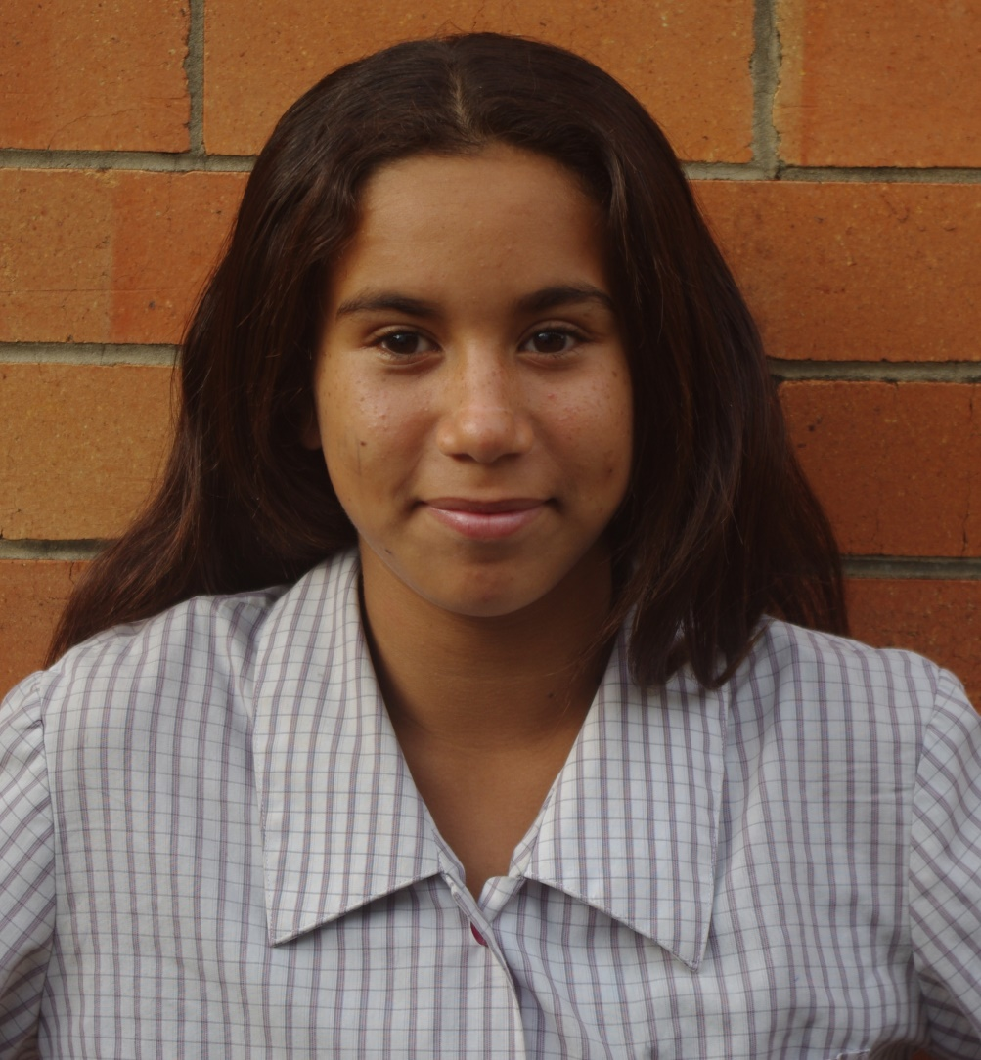
Disrespectful?
Smart?

Slide 9
Smart?

Slide 10
Bigotry is learned behaviour
#STAW

Slide 11
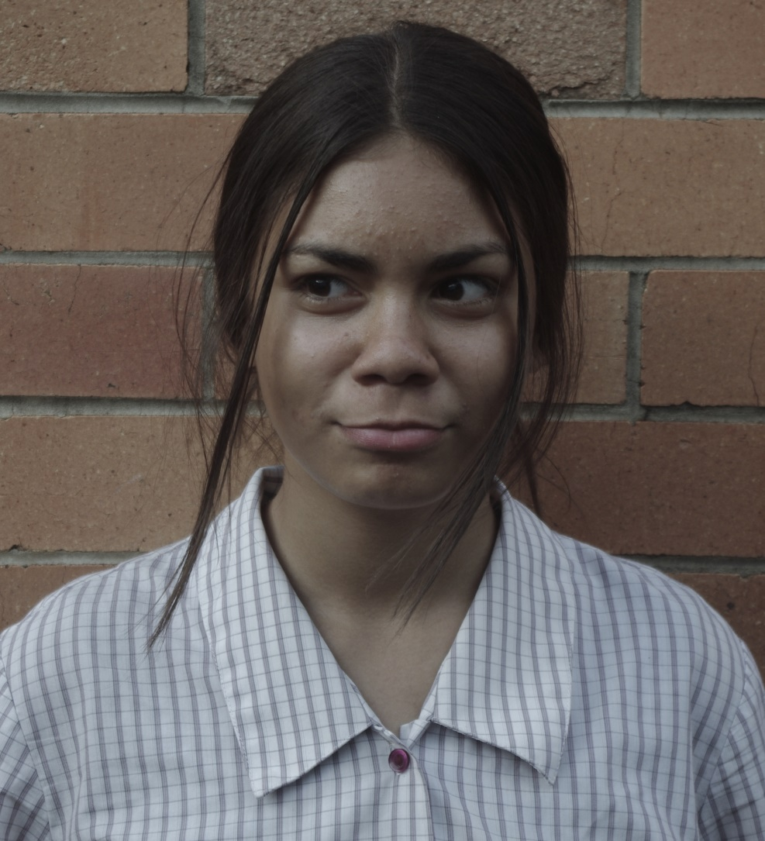
Truant?

Slide 12
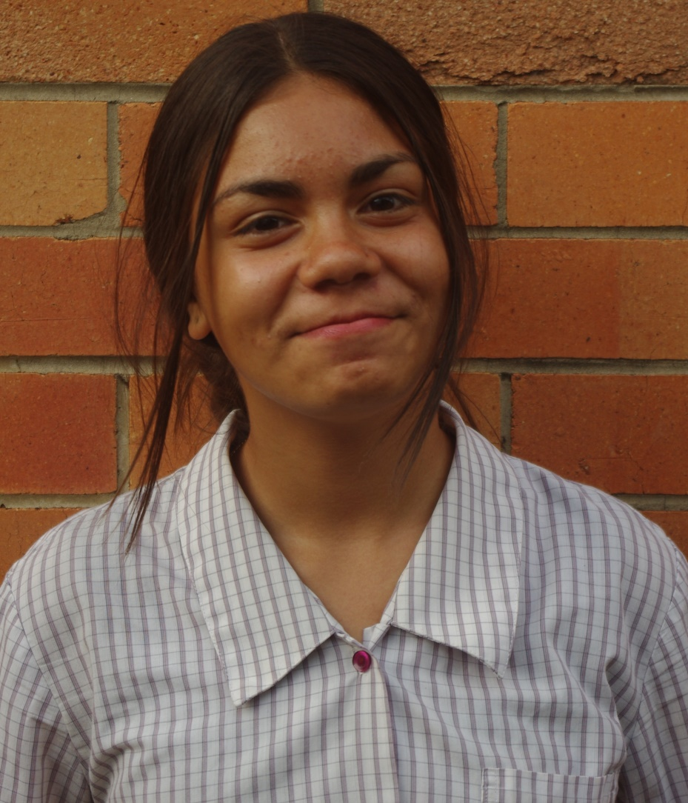
Truant?
Sister?

Slide 13
Sister?

Slide 14
Respect is learned behaviour
#STAW

Slide 15
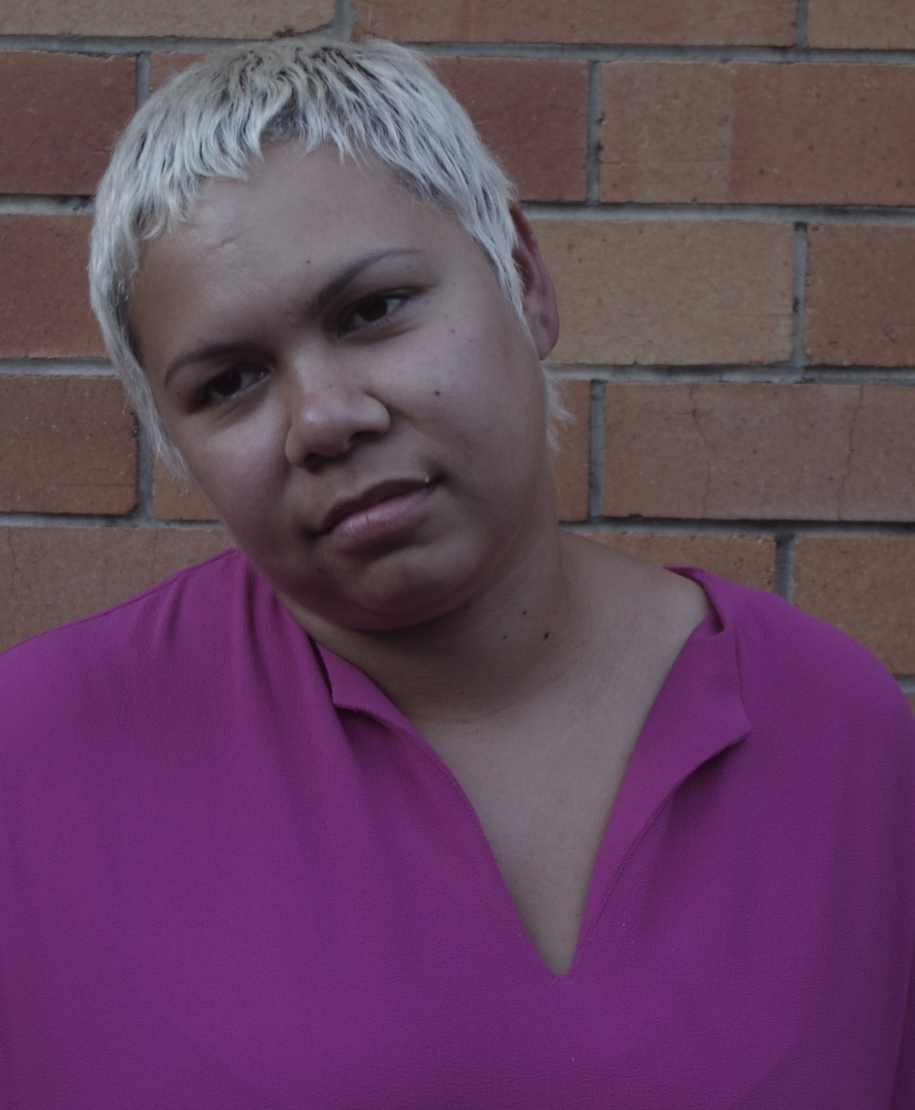
Thief?

Slide 16
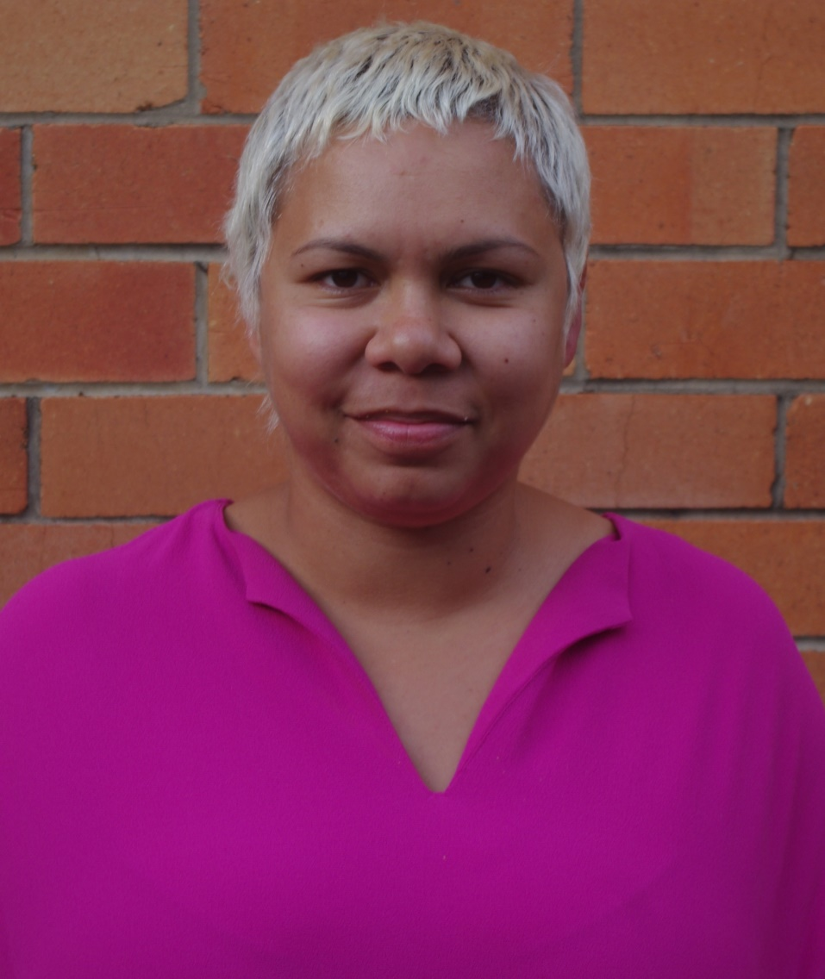
Thief?
Artist?

Slide 17
Artist?

Slide 18
Look at people differently
#STAW

Slide 19
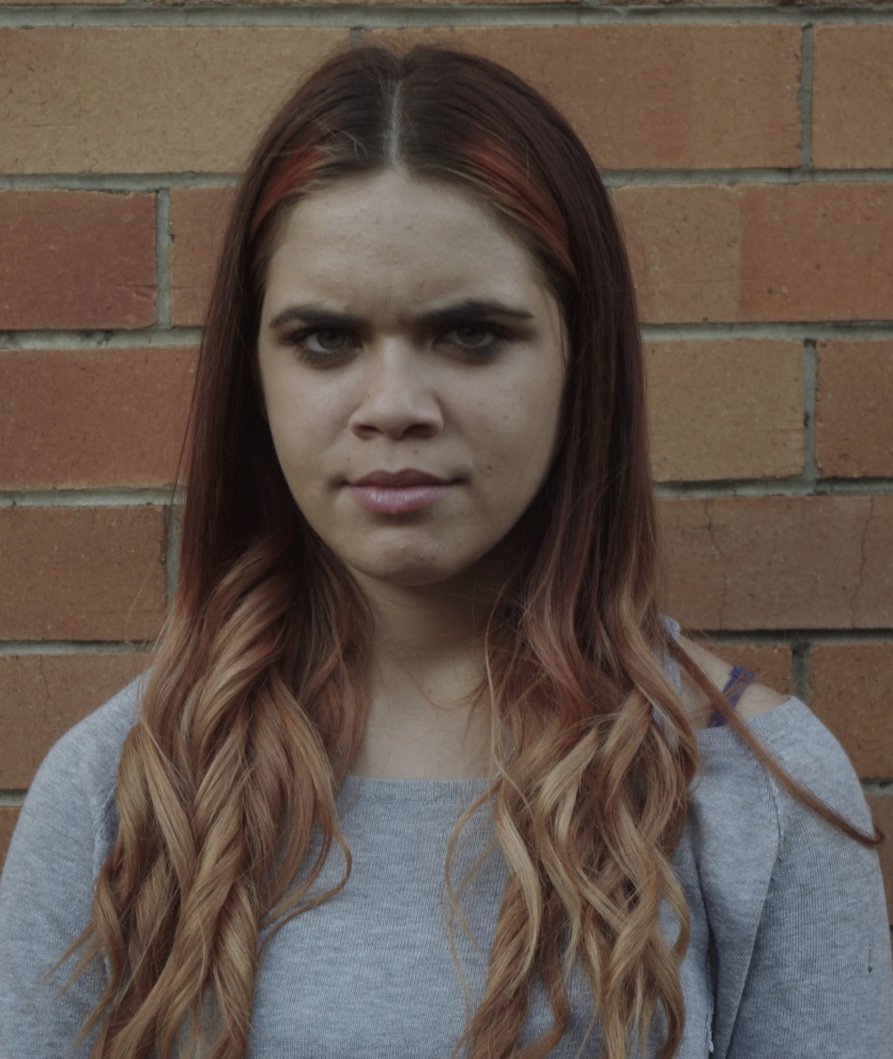
Liar?

Slide 20
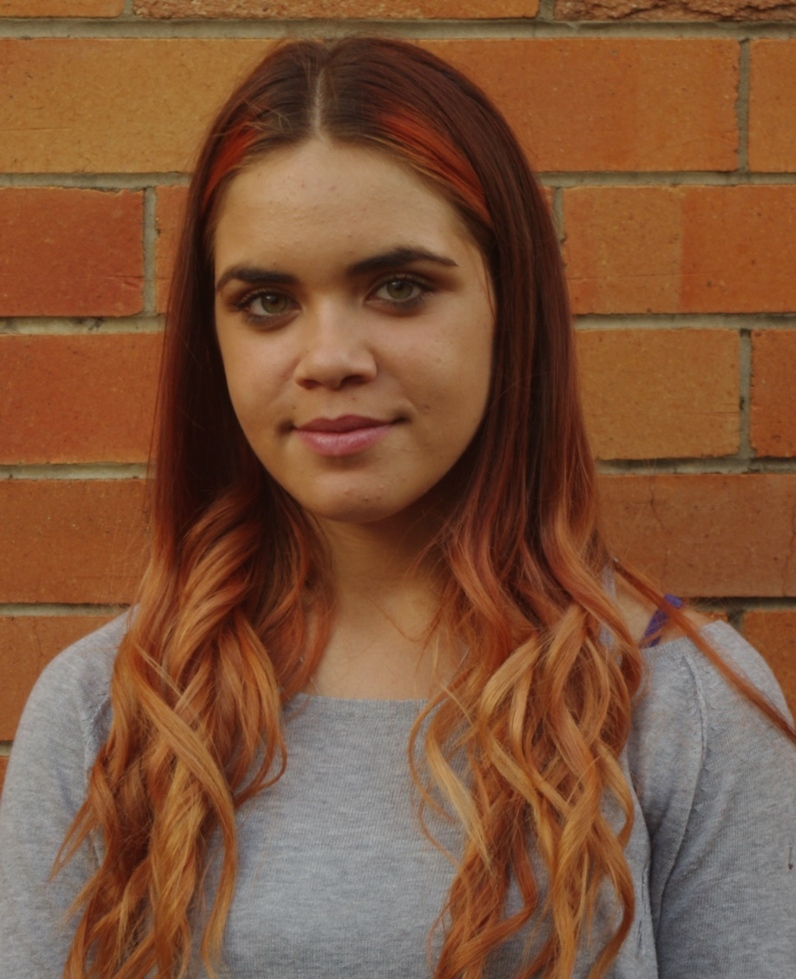
Liar?
Friend?

Slide 21
Friend?

Slide 22
Everyone is important
#STAW

Slide 23
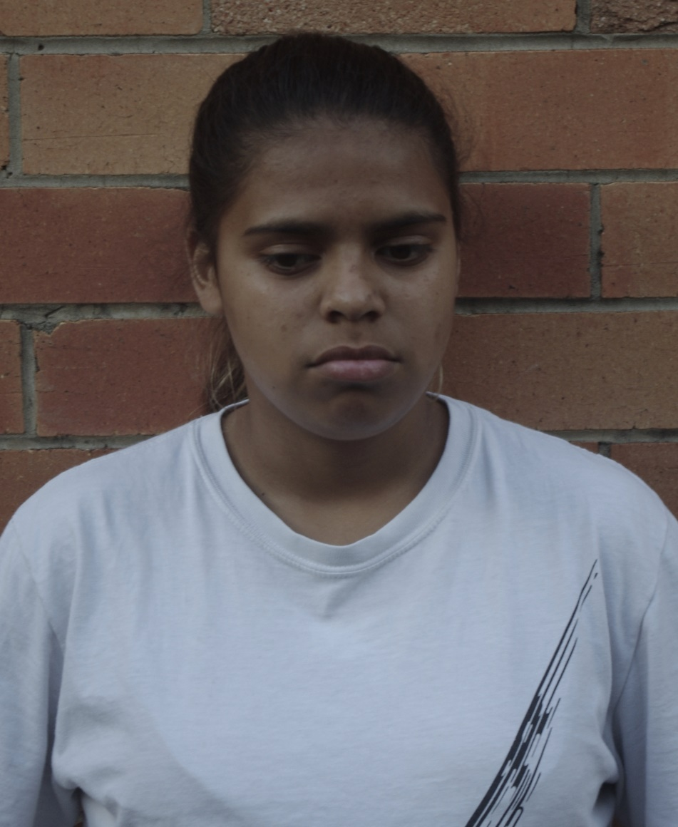
Criminal?

Slide 24
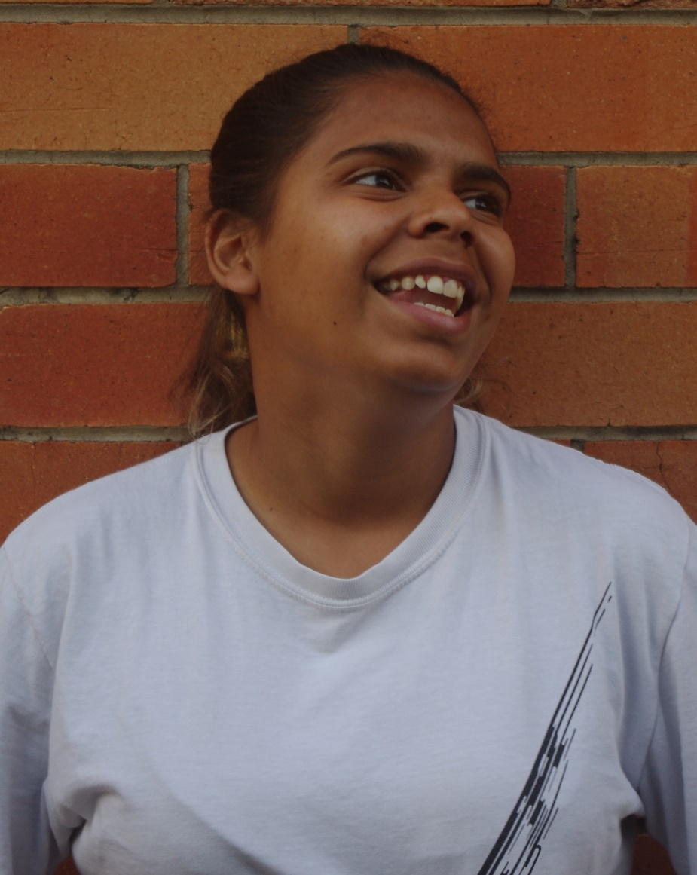
Criminal?
Generous?

Slide 25
Generous?

Slide 26
How do you want to be seen?
#STAW

Slide 27
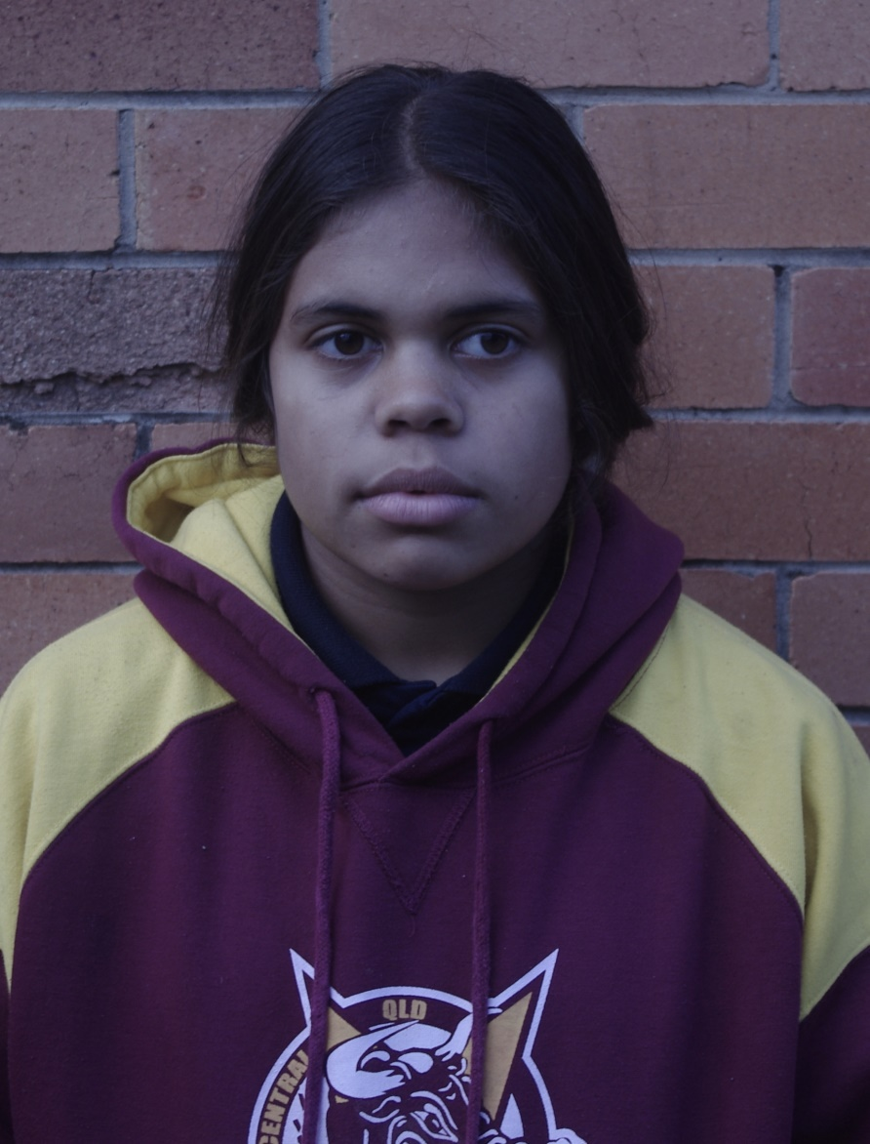
Violent?

Slide 28
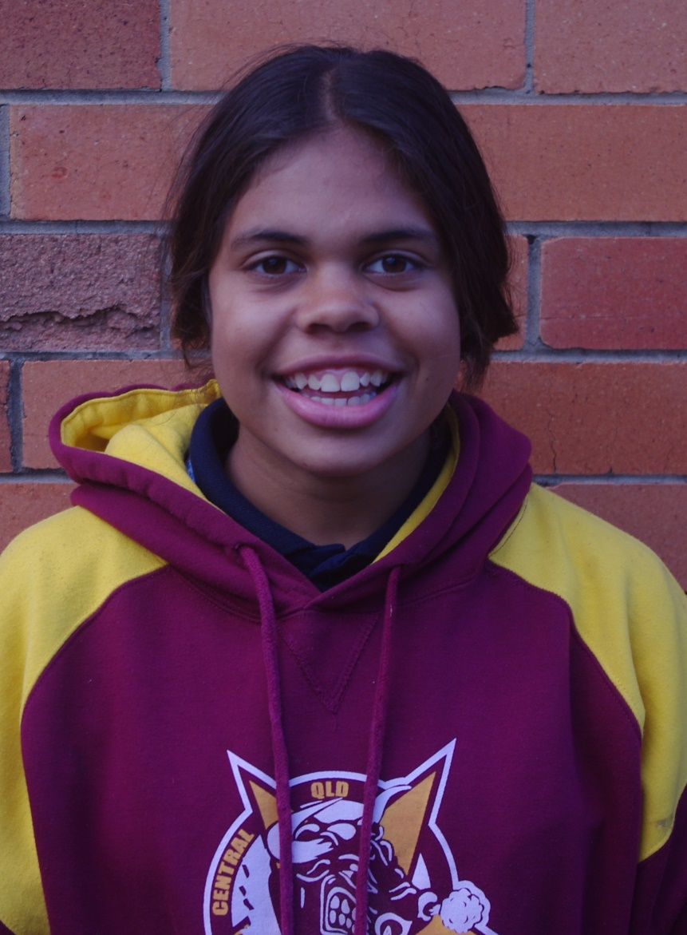
Violent?
Trustworthy?

Slide 29
Trustworthy?

Slide 30
Women deserve more
#STAW

Slide 31
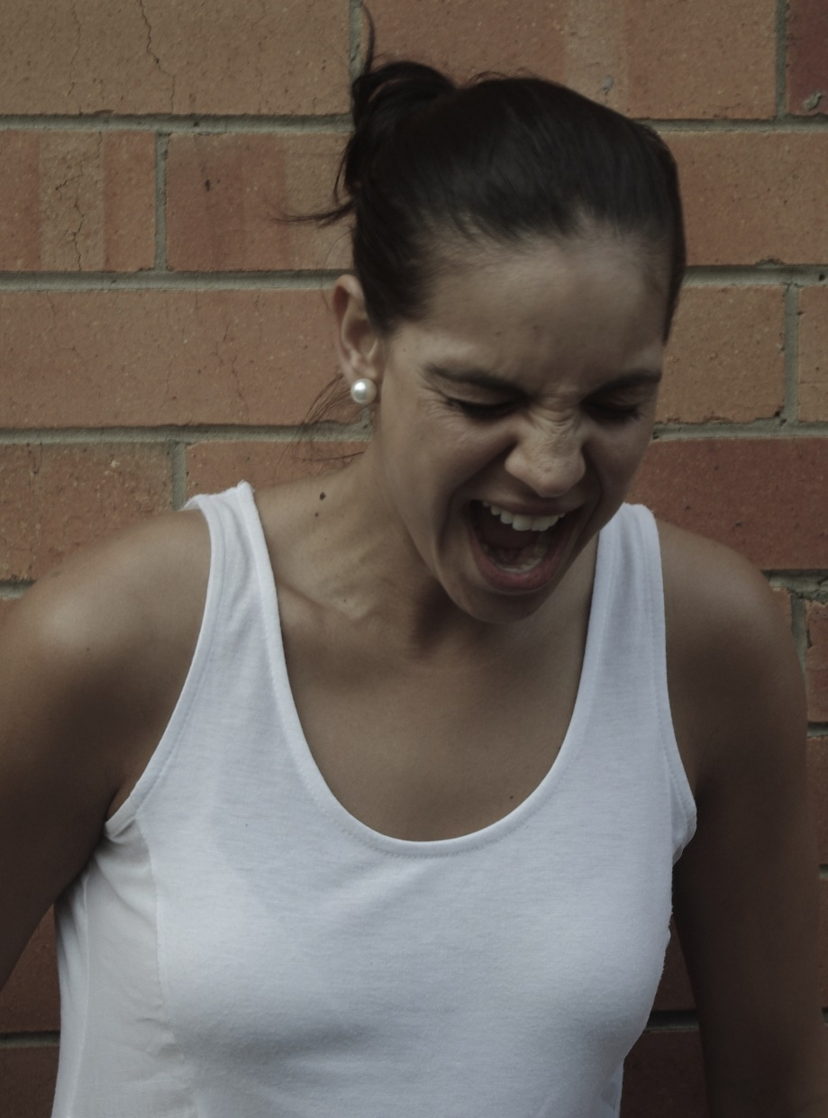
Drunk?

Slide 32
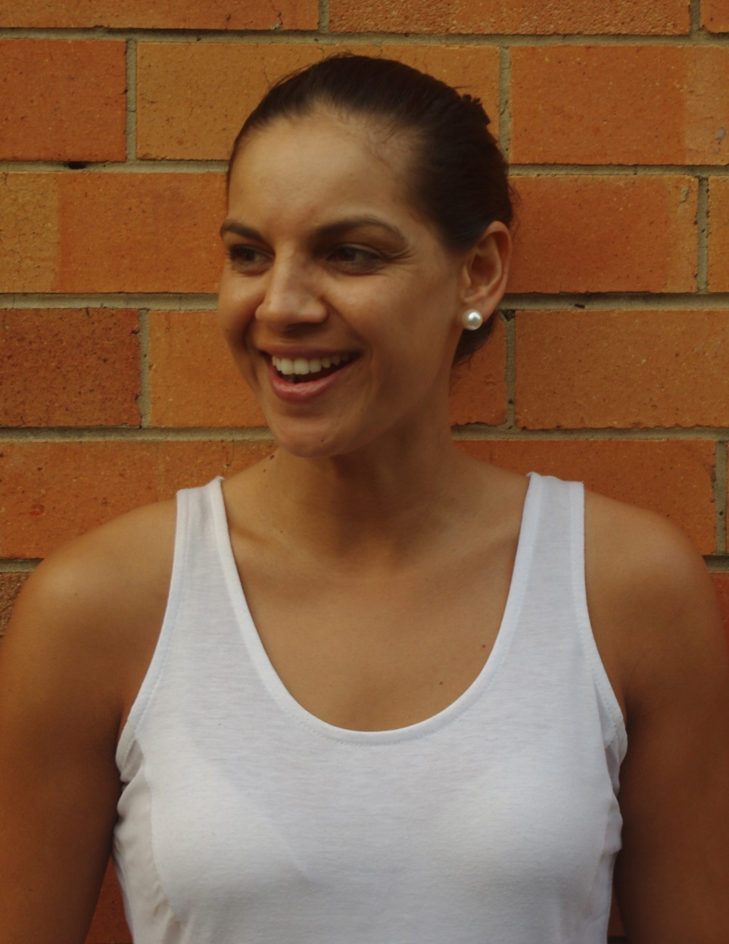
Drunk?
Graduate?

Slide 33
Graduate?

Slide 34
Women deserve better
#STAW

Slide 35
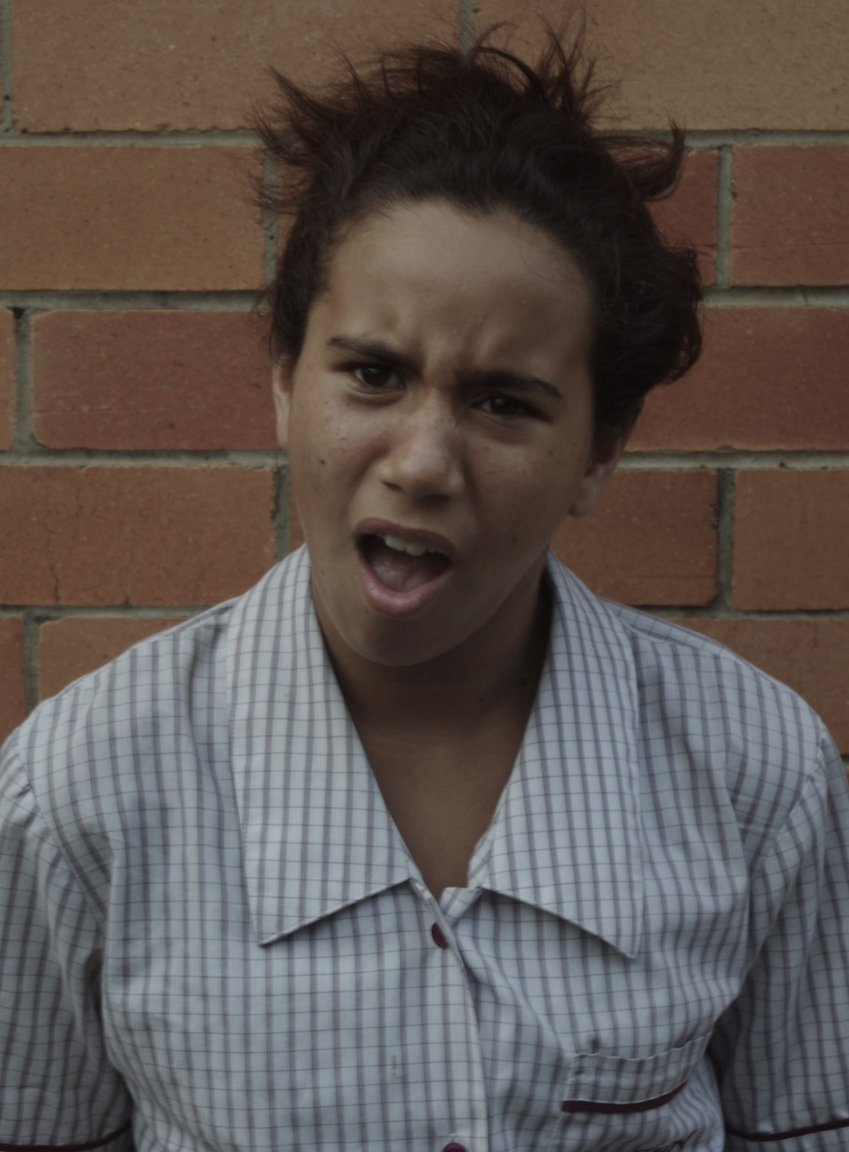
Bully?

Slide 36
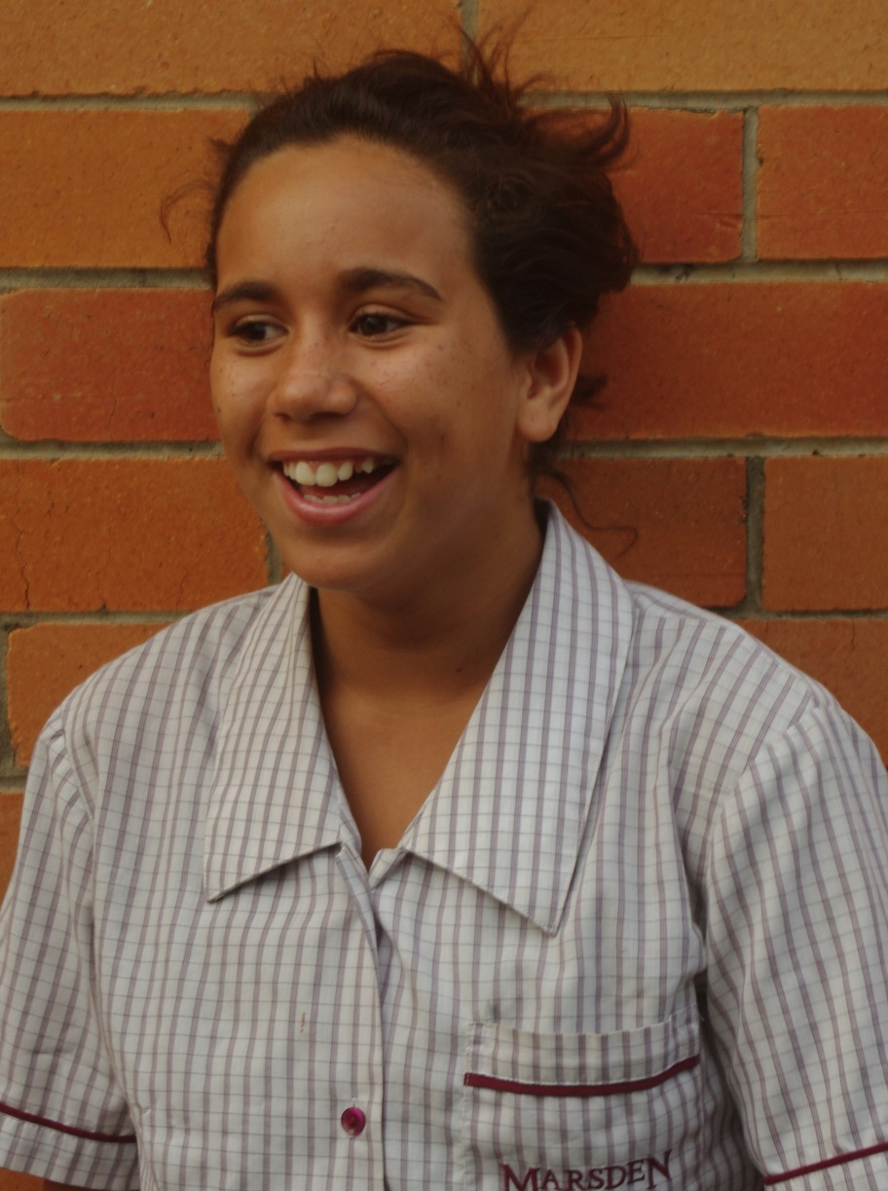
Bully?
Athlete?

Slide 37
Athlete?

Slide 38
We can do this
#STAW

Slide 40

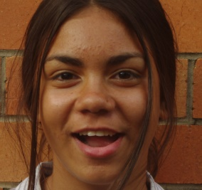
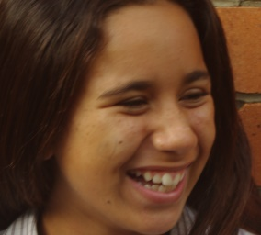
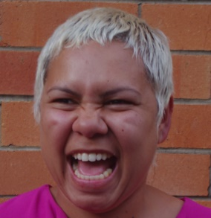
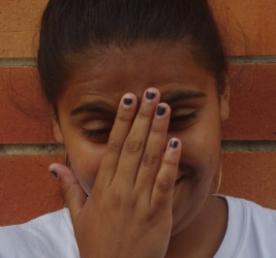
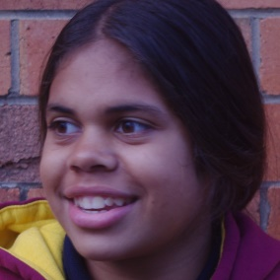
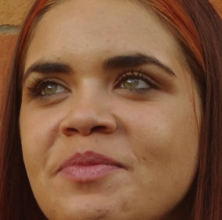
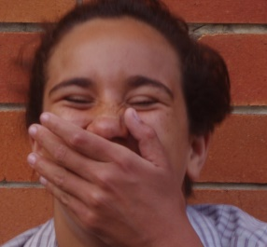
Thanks to
Jamia Monsell
Kariesha Purcell
Kelisha Roma
Kearra Roma
Zofia Waziak
Neta-Rie Mabo
Jadie Skeen
Jamieka Wiley

Slide 41
#STAW

Slide 42

#STAW

Slide 43
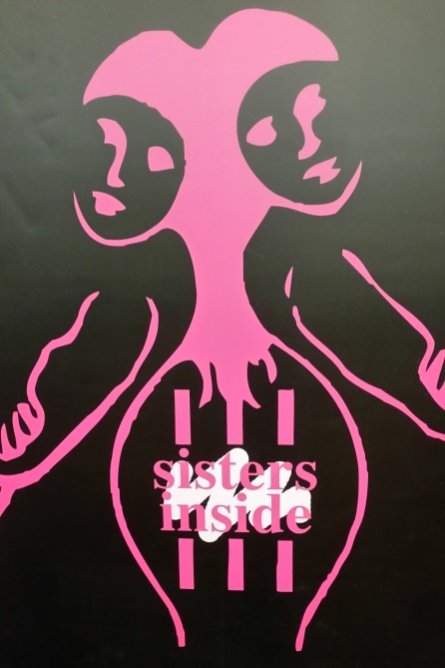
#STAW

Slide 44
#STAW

